Slide 1


DEEP FEATURE TRANSFER FROM DEEP LEARNING MODELS INTO MACHINE LEARNING ALGORITHMS
TO CLASSIFY COVID-19 FROM CHEST X-RAY IMAGES
M.Sc. THESIS
Ozan GÜLDALİ
Thesis Advisor: Assist. Prof. Dr. Gül İNAN
25.08.2021
Notes:
Hi, I am Ozan Guldali. My advisor assistant proffesor Gul Inan and I studied on Deep Feature Transfer from Deep Learning models into machine learning algorithms to classify covid19 from chest xray images. And it is the defending presentation of this thesis.

Slide 2
Outline
Introduction Introduction to Deep Learning Introduction to Machine Learning Experiments Results Conclusion and Recommendations
Notes:
I will start with Introduction, then continue with Intoduction to deep learning, introduction to machine learning, experiments, results and end with conclusion and recommendations.

Slide 3
Introduction
Purpose of Thesis Literature Review Chest X-Ray
Notes:
Introduction includes the purpose of thesis, literature review and chest xrays.

Slide 4
Introduction
Coronaviruses are a family of RNA related viruses causing
respiratory diseases in animals and humans.
In December 2019 a novel coronavirus was identified in Wuhan city
of China and spread across the country in a short time.
On 11 March, 2020, WHO declared a global pandemic
due to the worldwide spread of the COVID-19.
As of June 15, 2021, COVID-19 has caused more than 176 million people
to be infected and more than 3.8 million deaths worldwide, and continues to spread globally.
Detecting and distinguishing COVID-19, pneumonia and similar diseases from chest X-rays may be a difficult task
even for expert radiologists.
The recent advances in deep learning and machine learning algorithms also open a venue for proposing
alternative approaches or developing new algorithms for detection of COVID-19 which can be served as a smart-assistance
tool for medical doctors and radiologists whose workload has always been very heavy during the pandemic.
Notes:
Coronaviruses are a family of RNA related viruses causing respiratory diseases in animals and humans.
In December 2019 a novel coronavirus was identified in Wuhan / China and spread across the country in a short time.
In March 2020, world health organization declared a global pandemic on covid-19.
As of June 2021, more than hundred seventy six million people were infected and more than three point eight million people were died due to covid-19.
Thus, detecting and distinguishing covid-19 and similar diseases are very important. And performing this from chest X-rays may be difficult even for experts.
However, the recent advances in deep learning and machine learning create alternative approaches and become smart-assistance tools for medical doctors and radialogists to detect covid-19.

Slide 5
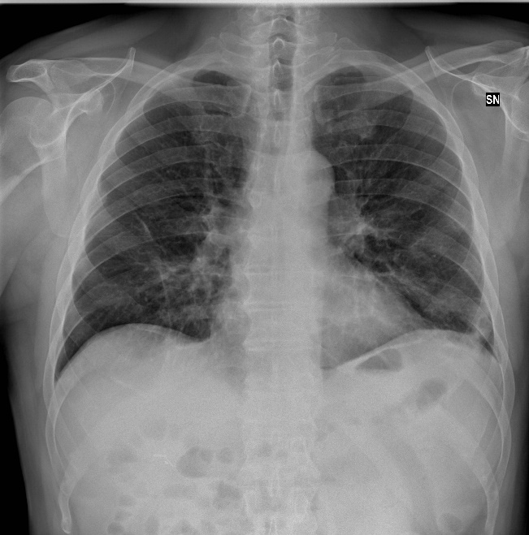
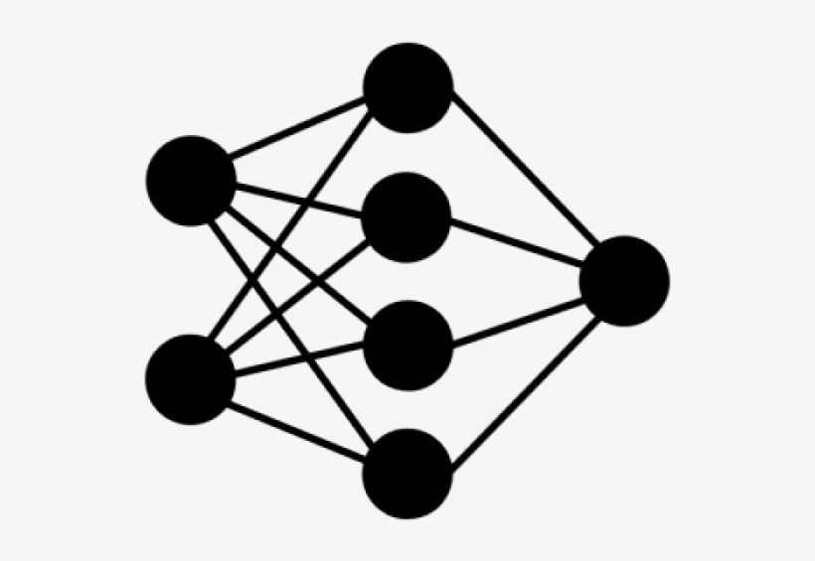

Purpose of Thesis
The scope of this thesis is two fold:
To show the capability of joint use of deep learning algorithms and machine learning algorithms, and
To apply this knowledge onto an on-going global public health problem.
Dataset consists of chest X-Ray image and demographic information
Pre-Trained CNN models
ML classification algorithms
Deep Feature Matrix
Deep Feature Extraction
COVID-19
Joint Feature Matrix
non-COVID-19
Age
Gender
Demographic Information Feature Matrix
Notes:
The scope of this thesis is two fold:
First, to show the capability of joint use of deep learning algorithms and machine learning algorithms, and
Second, to apply this knowledge onto an on-going global pandemic health problem.
Figure shows a quick pipeline of our work.

Slide 6
Literature Review
Authors | Technique | Dataset | The Number of Classes | Accuracy (%) | Sensitivity (%) | Specificity (%)
Ardakani et al. (2020) | ResNet-101 CNN model | Chest CT images | 3 | 99.51 | 100.00 | 99.02
Pathak et al. (2020) | Deep transfer learning on ResNet-50 CNN model | Chest CT images | 3 | 93.02 | 91.46 | 94.78
Ozturk et al. (2020) | DarkCovidNet CNN model | Chest X-Ray images | 3 | 87.02 | 92.18 | 89.96
Ozturk et al. (2020) | DarkCovidNet CNN model | Chest X-Ray images | 2 | 98.08 | 95.13 | 95.30
Oh et al. (2020) | Patch-by-patch classification in ResNet-18 CNN based model after segmentation | Chest X-Ray images | 2 | 88.90 | 85.90 | 96.40
Elshennawy and Ibrahim (2020) | Pre-trained ResNet152V2 CNN model\end | Chest X-Ray images | 2 | 99.22 | 99.44 | 99.45
Al-falluji et al. (2020) | Deep transfer learning on the modified ResNet-18 CNN model | Chest X-Ray images | 2 | 96.73 | 94.00 | 100.00
Nour et al. (2020) | SVM classifier fed with deep features obtained from the novel proposed CNN model | Chest X-Ray images | 2 | 98.97 | 89.39 | 99.75
Notes:
As literature research, we reviewed different deep learning and machine learning applications on chest xrays and computer tomography images. The best result we encountered was the study of Arkadani et al with Resnet hunderd one CNN model technique.
The best appropriate work with our thesis we found was Nour et al with svm classifier fed with deep features.

Slide 7
Chest X-Ray
X-rays (or X-radiations) are electromagnetic waves which is
actually a type of radiation with wavelengths shorter than ultraviolet light.
Nowadays, X-rays are mostly used for medical and radiological imaging
in medical industry and for security reasons in public areas.
The fewest photons are absorbed by the air, while the most photons are
absorbed by the calcium in the bones. This is why bones appear white.
Fat and other soft tissues moderately absorb X-rays, so they appear gray.
Due to the aforementioned absorption properties of X-rays, the lungs appear blackish.
The most preferred projection methods are Posterior-Anterior (PA) and
Anterior-Posterior (AP) in which photon beams traverse from posterior to anterior and anterior to posterior respectively.
Chest X-ray imaging has a very significant role on detecting serious diseases such as pneumonia and its causes,
pneumothorax, heart failures, emphysema, lung cancer, broken ribs for years, and COVID-19 recently.
Notes:
X-rays are electromagnetic waves.
Nowadays, this technology is mostly used for medical industry and for security in public areas.
The fewest photons are absorbed by the air and most of them are absorbed by the calcium in the bones. Thus, bones appear white. Fat and other soft tissues moderately absorb X-Rays, so they appear gray. Due to the given absorption properties of X-rays, the lungs appear blackish.
The most preferred projection methods are Posterior-Anterior and Anterior-Posterior in which photon beams traverse posterior to anterior and anterior to posterior respectively
Chest X-rays has a very significant role on detecting diseases such as pneumonia and its causes, pneumothorax, heart failures, lung cancer, broken ribs for years, and covid-19 recently.

Slide 8
Introduction to Deep Learning
Loss Function and Optimization
Convolutional Neural Networks
Transfer Learning
AlexNet
Residual Neural Network
Visual Geometry Group
Notes:
Introduction to deep learning includes the loss function and optimziation, convolutional neural networks, transfer learning, alexnet, residual neural network and visual geometry group.

Slide 9
Introduction to Deep Learning
A neural network is a learning framework for machines using a collection of functions over hidden layers to understand
and translate an input data into a desired output.
Neural networks are made of nodes (neurons) which receive the parameters of incident links, process them, and
produces an output. These connections between the layer nodes are called as links including weight and bias parameters.
Weight and bias terms are learnable parameters related to input data, and must be updated to reach the optimal cost
value.
A neural network with no loops or cyclic links over nodes
is feed-forward networks, if the direction of its
information flow is straight-forward. To update and
find the most appropriate weight and bias values,
back-propagation is applied by using the negative
gradient of the loss function.
Notes:
A neural network is a collection of functions over hidden layers to understand and translate an input data into a desired output.
Neural networks are made of nodes which receive the parameters of incident links, process them, and produces an output. These connections between the layer nodes are called as links including weight and bias parameters.
Weight and bias terms are learnable parameters related to input data, and must be updated to reach the optimal cost value.
A neural network with no loops or cyclic links over nodes is feed-forward networks, if the direction of its information flow is straight-forward. During this process, the weights and bias values do not change.
To update and find the most appropriate weight and bias values, back-propagation is applied by using the negative gradient of the loss function.

Slide 10
Introduction to Deep Learning
An epoch is an iteration when the train data passes forward and backward through the whole neural network only once.
If an epoch is too large to enter the neural network at once, data in the epoch can be dived into several smaller batches.
The data group reserved to be used in learning process is called as train data.
Validation data which is strictly separated from train data can be used to validate and control the learning process
periodically.
The data group reserved to be used in testing process and strictly separated from train data is called as test data. The
training process should not see any of test data.
Notes:
An epoch is an iteration when the train data passes forward and backward through the whole neural network only once.
If an epoch is too large to enter the neural network at once, data in the epoch can be dived into several smaller batches.
The data group reserved to be used in learning process is called as train data.
The train data must be strictly separated from validation and test data, and should be only used on training process. At each epoch, the train data goes into the model as input, the neural network works for learning data, the losses and metrics are computed, and the losses are optimized.
Validation data which is strictly separated from train data can be used to validate and control the learning process periodically.
During the validation process, only losses and metrics are computed, and no optimization process is applied, for that reason, the weights and biases are stable.
The data group reserved to be used in testing process and strictly separated from train data is called as test data. The training process should not see any of test data.
Testing process is usually applied only at the end of all epochs. However, when the train data is not feasible to be divided into validation data, validation may be applied on test data.

Slide 11
Introduction to Deep Learning
A learning algorithm is appeared to have under-fitting at the time that it cannot capture or fit the data well.
When the model fits on the train data perfectly, it might have started to memorize the train data and may not learn
something new from the data. That is, the learnable parameters are directly adjusted for train data and not feasible for test data anymore. This situation is called as over-fitting.
Notes:
A learning algorithm is appeared to have under-fitting at the time that it cannot capture or fit the data well.
This may be caused by a deficient learning process or non-feasible hyper-parameters.
When the model fits on the train data perfectly, it might have started to memorize the train data and may not learn something new from the data. That is, the learnable parameters are directly adjusted for train data and not feasible for test data anymore. This situation is called as over-fitting.

Slide 12
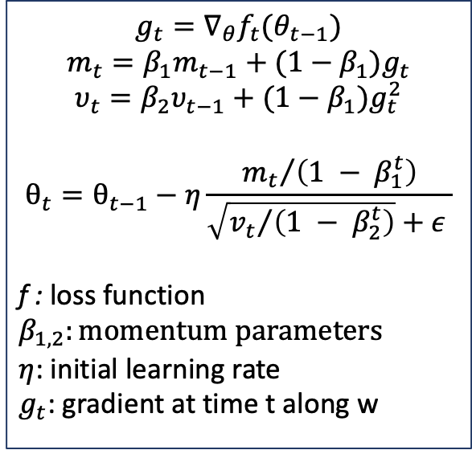
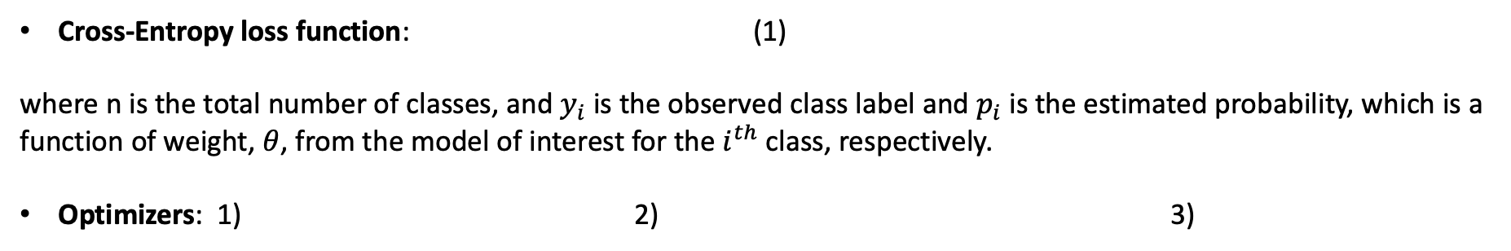
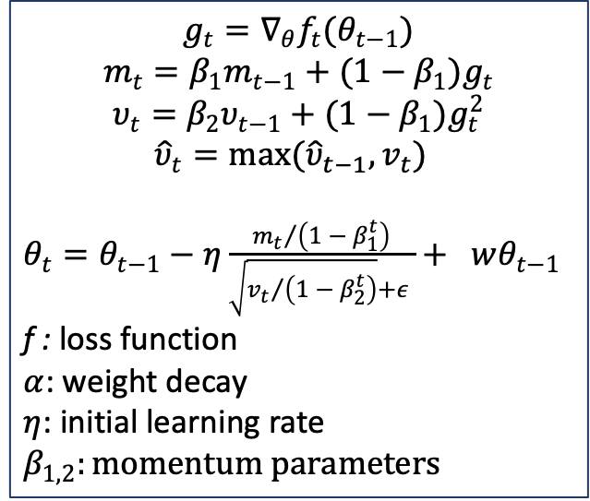
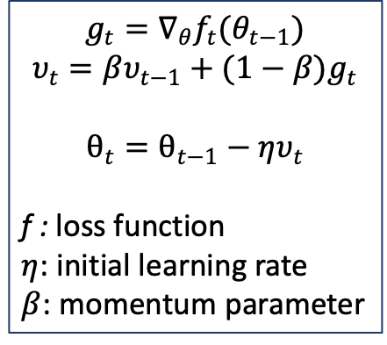
Loss Function and Optimization
Cross-Entropy loss function: (1)
where n is the total number of classes, and $y_{i}$ is the observed class label and $p_{i}$ is the estimated probability, which is a function of weight, $θ$, from the model of interest for the $i^{th}$ class, respectively.
Optimizers: 1) 2) 3)
Adam
SGD Momentum
AdamW
$$g_{t}=∇_{θ}f_{t}(θ_{t−1})$$
$$m_{t}=β_{1}m_{t−1}+(1−β_{1})g_{t}$$
$$υ_{t}=β_{2}υ_{t−1}+(1−β_{1})g_{t}^{2}$$
$$θ_{t}=θ_{t−1}−η\frac{{m_{t}}/{\left(1 − β_{1}^{t}\right)}}{\sqrt{{v_{t}}/{\left(1 − β_{2}^{t}\right)}}+ε }$$
f : loss function
$$β_{1,2}:momentum parameters$$
$η$: initial learning rate
$g_{t}$: gradient at time t along w
$$g_{t}=∇_{θ}f_{t}(θ_{t−1})$$
$$υ_{t}=βυ_{t−1}+(1−β)g_{t}$$
$$θ_{t}=θ_{t−1}−ηυ_{t}$$
f : loss function
$η$: initial learning rate
$β$: momentum parameter
$$g_{t}=∇_{θ}f_{t}(θ_{t−1})$$
$$m_{t}=β_{1}m_{t−1}+(1−β_{1})g_{t}$$
$$υ_{t}=β_{2}υ_{t−1}+(1−β_{1})g_{t}^{2}$$
$${\hat{υ}}_{t}=\max{({\hat{υ}}_{t−1}, v_{t}) }$$
$θ_{t}=θ_{t−1}−η\frac{{m_{t}}/{\left(1 − β_{1}^{t}\right)}}{\sqrt{{v_{t}}/{\left(1 − β_{2}^{t}\right)}}+ε }+ wθ_{t−1}$
f : loss function
$α$: weight decay
$η$: initial learning rate
$$β_{1,2}:momentum parameters$$
Notes:
The loss function used in our work was cross-entropy loss function which can be seen in equation one.
The optimizers to optimize this loss function we used were adam, sgd momentum and adam with decoupled weight decay.

Slide 13
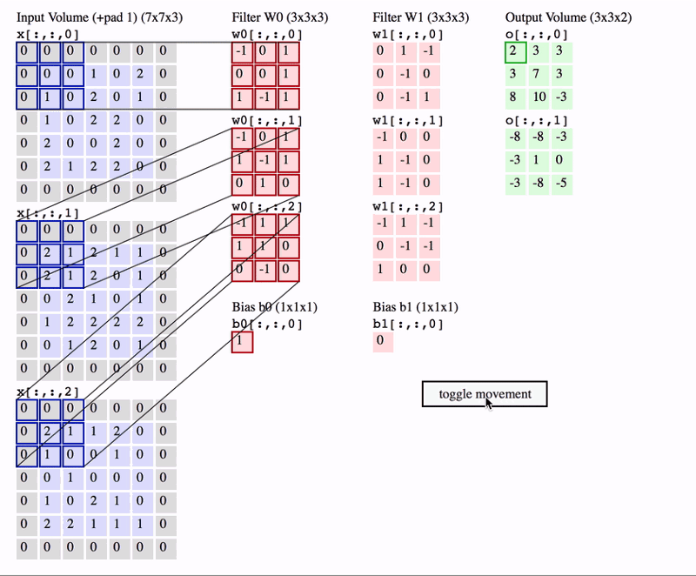
Convolutional Neural Networks
The convolutional neural networks (CNNs) are the special research area of deep neural networks
which are mostly used in visual problem analyzing and solving.
Convolutional layer is used to reveal the distinctive features of
input data. It includes windows named as filter (or kernel) that
traverse through input matrix with the step size named as stride.
Filling the edges of input by zeros to clear the inconsistency between
filter, stride and input sizes is called as padding.
https://www.freecodecamp.org/news/an-intuitive-guide-to-convolutional-neural-networks-260c2de0a050/
Notes:
The convolutional neural networks (CNNs) are the special research area of deep neural networks which are mostly used in visual problem analyzing and solving.
Convolutional layer is used to reveal the distinctive features of input data. It includes windows named as filter that traverse through input matrix with the step size named as stride.
Filling the edges of input by zeros to clear the inconsistency between filter, stride and input sizes is called as padding.
In the figure, we have an input matrix in the size of seven times seven times three and padding with the size of one is applied. There are two filters in the size of three times three and they scan the input with the stride of two.

Slide 14
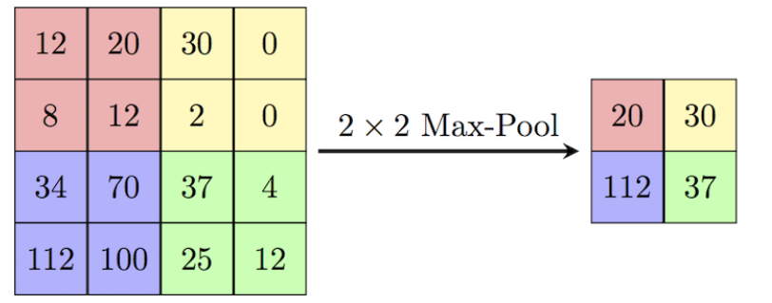
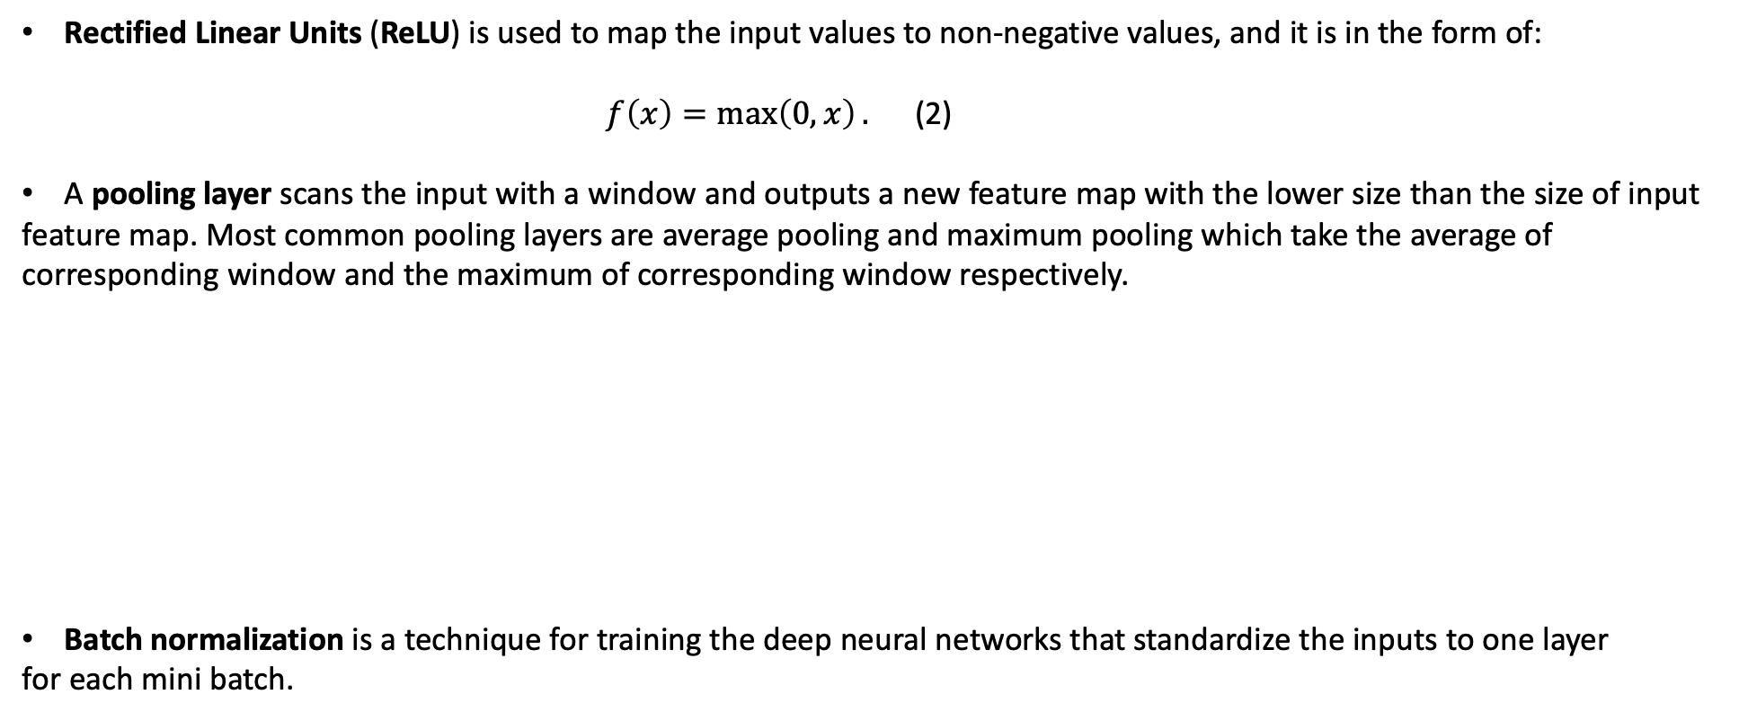
Convolutional Neural Networks
Rectified Linear Units (ReLU) is used to map the input values to non-negative values, and it is in the form of:
$f\left(x\right)=\max\left(0, x\right).$ (2)
A pooling layer scans the input with a window and outputs a new feature map with the lower size than the size of input
feature map. Most common pooling layers are average pooling and maximum pooling which take the average of
corresponding window and the maximum of corresponding window respectively.
Batch normalization is a technique for training the deep neural networks that standardize the inputs to one layer
for each mini batch.
Notes:
Rectified Linear Units (ReLU) is used to map the input values to non-negative values.
A pooling layer scans the input with a window and outputs a new feature map with the lower size than the size of input feature map. Most common pooling layers are average pooling and maximum pooling layers.
Batch normalization is a technique for training the deep neural networks that standardize the inputs to one layer for each mini batch.

Slide 15
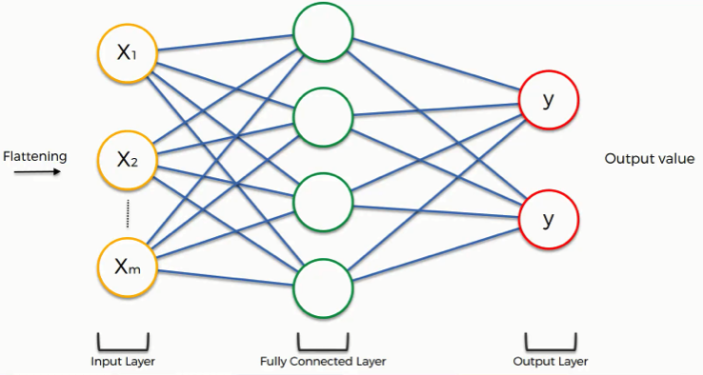
Convolutional Neural Networks
Drop-out is the removing operation of the nodes below certain threshold value in the network at each training iteration.
Flattening maps the input into one-dimension before fully-connected layers.
The fully-connected layers are used to classify data in different categories, or construct feature maps to be used in
another artificial network methods.
Notes:
Drop-out is the removing operation of the nodes below certain threshold in the network at each training iteration.
In other words, it is aimed not to use weak information and memorize the network.
Flattening maps the input into one-dimension before fully-connected layers.
The fully-connected layers are used to classify data in different categories, or construct feature maps to be used in
another artificial network methods.

Slide 16
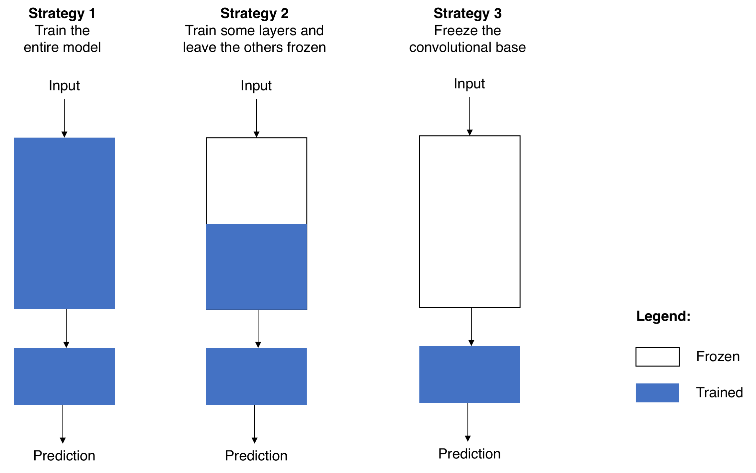
Transfer Learning
Transfer learning is transferring the weights, features etc. in a pre-trained model to another artificial learning model
which can be in the same type such as both them are deep learning models via pre-trained models or can be in different
types such as transferring from a deep learning model to a machine learning model via deep feature transfer.
To prepare a pre-trained CNN model for visual artificial intelligence problems, ILSVRC 2012 ImageNet data set,
including 1000 class with large data, is commonly used to train the model and share the model weight files.
Here, there are tree different main strategies to use
the pre-computed weights for training, and choosing one
of them is a fine-tuning process:
Notes:
Transfer learning is transferring the weights, features etc. in a pre-trained model to another artificial learning model which can be in the same type or different types.
To prepare a pre-trained CNN model for visual artificial intelligence problems, ImageNet dataset is commonly used to train the model and share the model weight files.
Afterwards, a desired pre-trained model is called together with its pre-computed weights, and the weights are transferred into the same empty neural network. Then the last fully-connected layer is adapted to the problem by being updated or adding new fully-connected layers to it.
Here, there are tree different main strategies to use the pre-computed weights for training:
Straregy one is training the entire model initialized with pre-computed weights.
Strategy two is freezing some of the convolutional layers from beginning, and training the rest initialized with pre-computed weights.
Strategy three is freezing all convolutional layers.

Slide 17
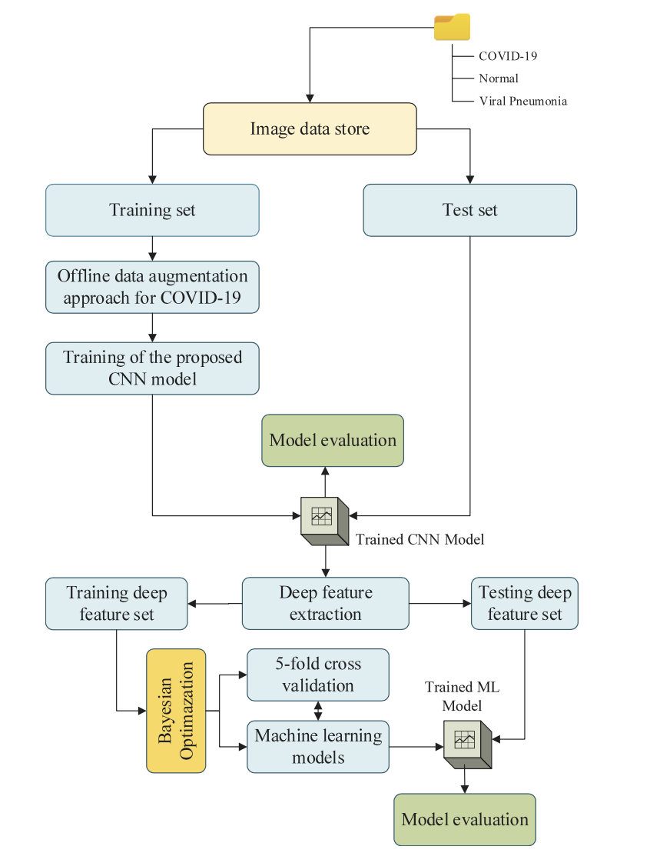
Transfer Learning
To prepare a deep feature set to be used in another
artificial learning model, such as machine learning models,
the features on a fully-connected layer, mostly the first or
second, are extracted and saved.
Then the saved deep features are used in the target artificial
learning model as the feature map of data set.
In the figure;
Firstly, the image dataset was divided into training and testing sets.
Then the CNN model was trained on training set and tested on testing set.
After that, the trained CNN model weights were used to extract the deep features of training and testing sets prepared at the beginning.
At the end, the machine learning model were trained on the deep features of training set and tested on the deep features of testing set.
Notes:
To prepare a deep feature set to be used in another artificial learning model, such as machine learning models, the features on a fully-connected layer, mostly the first or second, are extracted and saved.
Then saved deep features are used in the target artificial learning model as the feature map of dataset.
In the figure:
Firstly, the image dataset was divided into training and testing sets.
Then the CNN model was trained on training set and tested on testing set.
After that, the trained CNN model weights were used to extract the deep features of training and testing sets prepared at the beginning.
At the end, the machine learning model were trained on the deep features of training set and tested on the deep features of testing set.

Slide 18
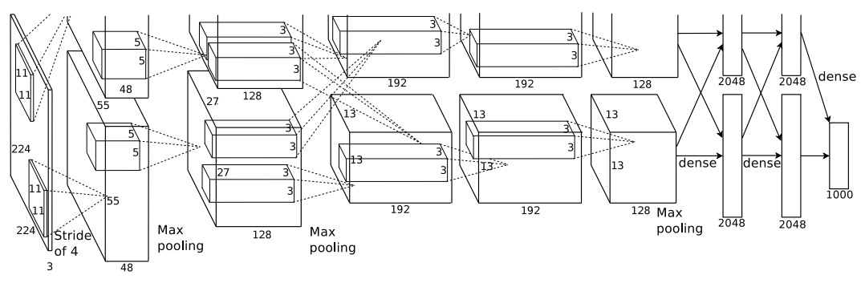
AlexNet
The AlexNet architecture was developed by Krizhevsky et al. for the object recognition problems.
The architecture starts with an input layer and then five convolution layers which use filters of size of 11x11
with a stride value of 4, where some of them are supported by the maximum pooling.
After the convolutional block, there are tree fully-connected layers where the last output is in the size of class size.
Notes:
The AlexNet architecture was developed for the object recognition problems.
The architecture starts with an input layer and then five convolution layers which use filters of size of eleven times eleven with a stride value of four, where some of them are supported by the maximum pooling.
After the convolutional block, there are tree fully-connected layers where the last output is in the size of class size.
---
In the figure, the output size is seen as 1000, since the illustration is constructed for a 1000-class problem.

Slide 19
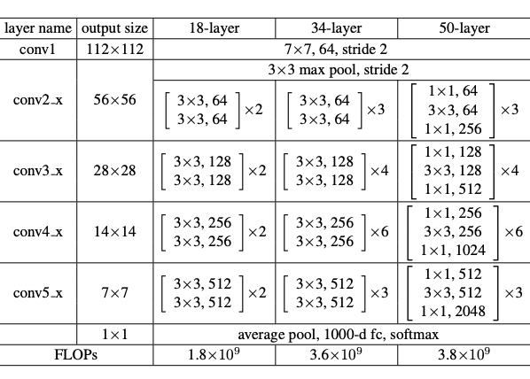
Residual Neural Network
The Residual Neural Network (ResNet) architecture was proposed by He et al. to avoid vanishing and exploding gradient
problems by using residual blocks which is a simple connection which takes the activation from one layer and feeds it to
another layer in much deeper.
A ResNet model starts with an input layer with a 7x7 filter and the stride of 2 and continue with maximum pooling layer
with a 3x3 window and the stride of 2. Following this input layer;
ResNet-18 architecture includes 8 residual blocks, where each includes
2 convolutional layers with a 3x3 filter.
ResNet-34 architecture includes 16 residual blocks, where each includes
2 convolutional layers with a 3x3 filter.
ResNet-50 architecture includes 16 residual blocks, where each includes
3 convolutional layers with a 3x3 filter.
After the convolutional layers, there is an average pooling layer following a fully-connected layer with the output size
as the number of classes.
Notes:
The Residual Neural Network (ResNet) architecture was proposed to avoid vanishing and exploding gradient problems by using residual blocks.
A ResNet model starts with an input layer with a seven times seven filter and the stride of two and continue with maximum pooling layer with a three times three window and the stride of two.
Following this input layer, resnet18 includes 8 residual blocks each including 2 convolutional layers, resnet34 includes 16 blocks each including 2 convolutional layers and resnet50 includes 16 blocks each including 3 convolutional layers.
After the convolutional layers, there is an average pooling layer following a fully-connected layer with the output size as the number of classes.

Slide 20
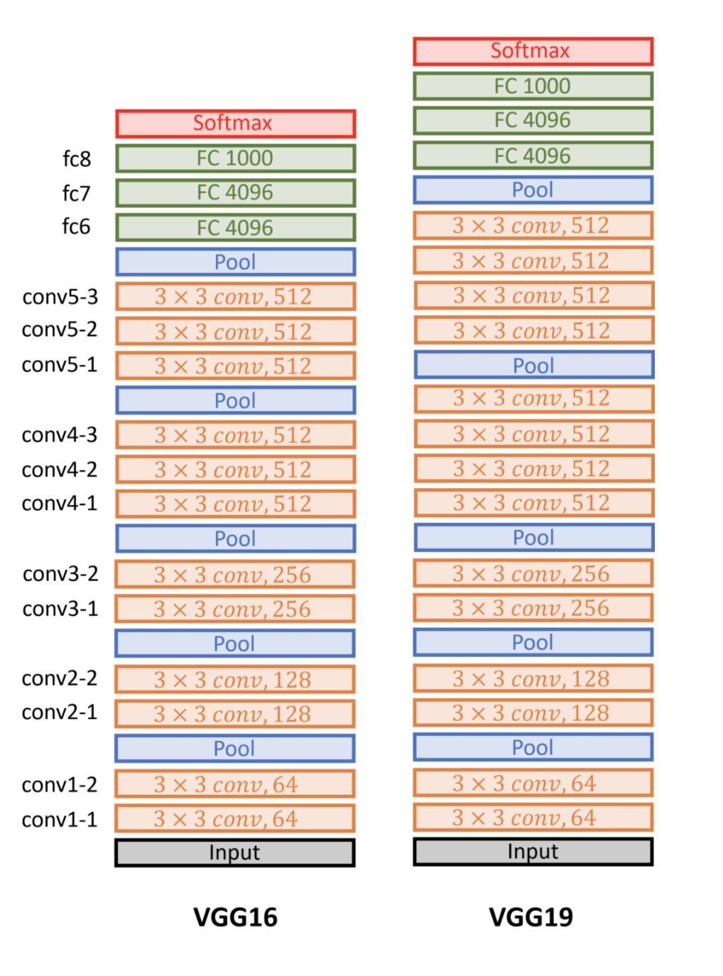
Visual Geometry Group
The Visual Geometry Group (VGG) network was proposed by Simonyan and Zisserman as a very profound architecture
for the problem of image recognition.
The model architecture starts with an input layer.
Following that, there are 12 convolution layers using 3x3 filters in VGG16,
and 14 convolution layers using 3x3 filters in VGG19 architecture.
There are a total of 5 maximum pooling layers used after some convolution
layers. In maximum pooling, 2x2 windows were used with stride as 2.
After the convolution layers, there are three fully-connected layers
such that final output size is the number of classes.
Notes:
The Visual Geometry Group (VGG) network was as a very profound architecture for the problem of image recognition.
The model architecture starts with an input layer.
Following that, there are twelve convolution layers using three times three filters in vgg16, and fourteen convolution layers using three times three filters in vgg19.
There are total of five maximum pooling layers used after some convolution layers. In maximum pooling, two times two windows were used with stride as two.
After the convolution layers, there are three fully-connected layers such that final output size is the number of classes.

Slide 21
Introduction to Machine Learning
Cross Validation
Regularization
Support Vector Machines
Logistic Regression
K-Nearest Neighbor
Linear Discriminant Analysis
Notes:
Introduction to machine learning includes cross validation, regularization, support vector machines, logistic regression, k nearest neighbor and linear discriminant analysis.

Slide 22
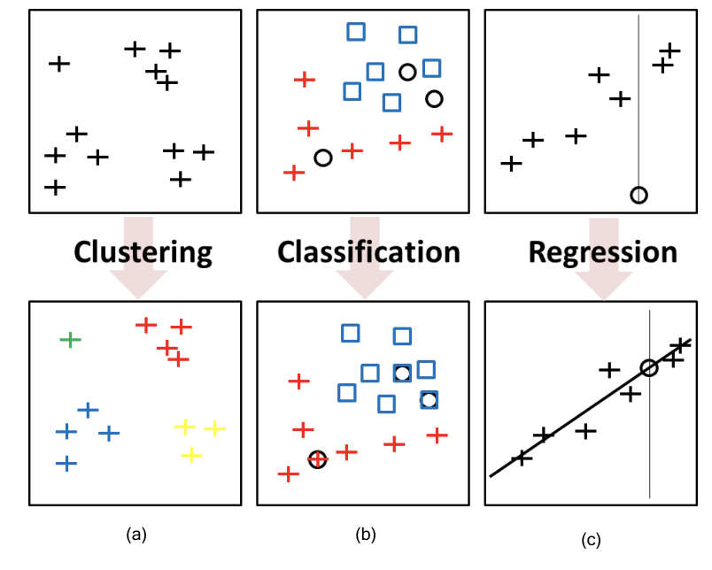
Introduction to Machine Learning
The goal of machine learning (ML) is to learn from available data or experiences to solve a given problem.
A traditional ML pipeline may be listed as follows:
defining the problem to solve,
collecting the data for training and testing,
designing or extracting the features describing data,
training the model to optimize the loss function by tuning the parameters through experiments, and
testing the model to evaluate the performance of trained model on unseen test data.
Supervised learning is a ML method that establishes a relationship
between each attribute of data feature map and
its target value. Estimating the output value for each new datum is the main goal.
The problems having data with unknown true values are solved by
unsupervised learning. Here, grouping the given data
is the main goal.
Notes:
The goal of machine learning (ML) is to learn from available data or experiences to solve a given problem.
A traditional ML pipeline can be constructed as:
defining the problem to solve,
collecting the data for training and testing,
designing or extracting the features describing data,
training the model to optimize the loss function by tuning the parameters through experiments, and
testing the model to evaluate the performance of trained model on unseen test data.
Supervised learning is a ML method that establishes a relationship between each attribute of data feature map and its target value.
Estimating the output value for each new datum is the main goal.
Regression and classification problems are solved by supervised learning approaches.
The problems having data with unknown true values are solved by unsupervised learning.
Here, grouping the given data is the main goal.
Clustering tasks are unsupervised learning approaches.

Slide 23
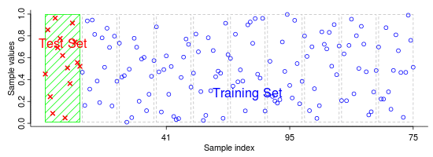
Cross Validation
In the cross-validation (CV) method, all the data is divided into train and test set.
In K-Fold CV, data is divided into K groups equally or unevenly in a random chosen way or specific distribution way.
The model trained and tested for K times independently. For each iteration one of the groups are chosen as test group,
and the remaining K-1 groups are merged to use as train set. Note that, the choice of K must be greater than 1.
If the K is chosen as the number of samples, say N, in data set, then this CV method is called as Leave-One-Out. Here,
the model is trained for N times.
https://imada.sdu.dk/~marco/Teaching/AY2010-2011/DM825/
Notes:
In the cross-validation (CV) method, all the data is divided into train and test set.
In K-Fold CV, data is divided into K groups equally or unevenly.
The model trained and tested for K times independently. For each iteration one of the groups are chosen as test group, and the remaining K minus one groups are merged to use as train set.
If the K is chosen as the number of samples, this CV method is called as leave one out. Here, the model is trained for N times.

Slide 24
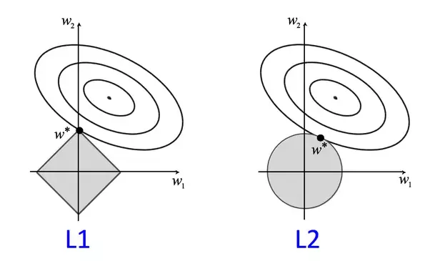
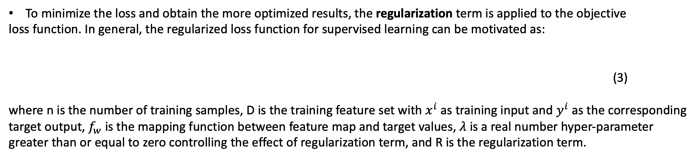
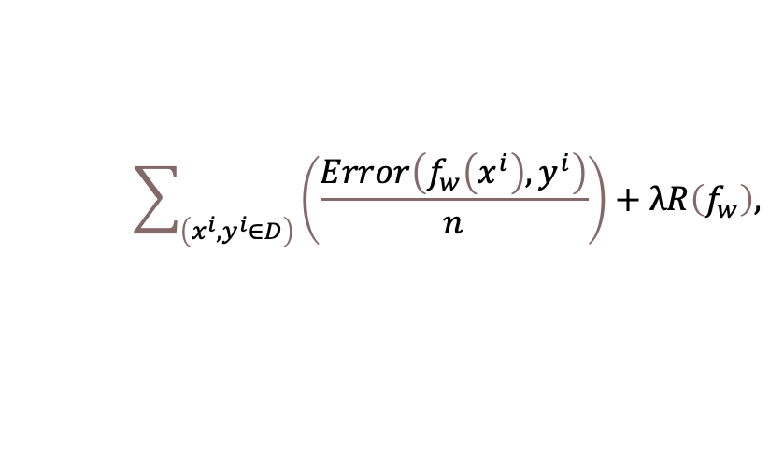
Regularization
To minimize the loss and obtain the more optimized results, the regularization term is applied to the objective
loss function. In general, the regularized loss function for supervised learning can be motivated as:
(3)
where n is the number of training samples, D is the training feature set with $x^{i}$ as training input and $y^{i}$ as the corresponding
target output, $f_{w}$ is the mapping function between feature map and target values, $λ$ is a real number hyper-parameter
greater than or equal to zero controlling the effect of regularization term, and R is the regularization term.
$$\sum_{\left(x^{i},y^{i}∈D\right)}{\left(\frac{Error\left(f_{w}\left(x^{i}\right),y^{i}\right)}{n}\right)}+λR\left(f_{w}\right),$$
Notes:
To minimize the loss and obtain the more optimized results, the regularization term is applied to the objective loss function. In general, the regularized loss function for supervised learning can be motivated as in equation three.
Here lambda is real valued hyper-parameter greater than or equal to zero, and R is the regularization term.

Slide 25
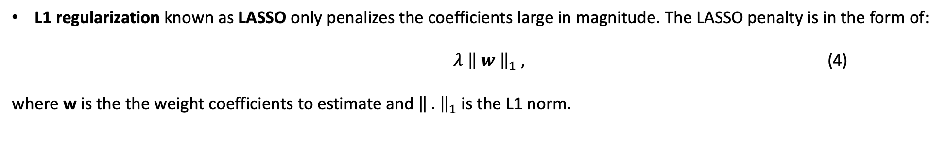
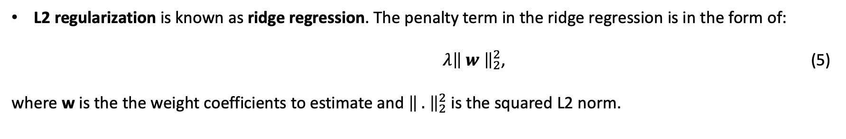
Regularization
L1 regularization known as LASSO only penalizes the coefficients large in magnitude. The LASSO penalty is in the form of:
$λ {\left\| w \right\|}_{1}$ , (4)
where w is the the weight coefficients to estimate and${ \left\| . \right\|}_{1}$ is the L1 norm.
L2 regularization is known as ridge regression. The penalty term in the ridge regression is in the form of:
$λ{\left\| w \right\|}_{2}^{2}$, (5)
where w is the the weight coefficients to estimate and ${\left\| . \right\|}_{2}^{2}$ is the squared L2 norm.
Notes:
L1 regularization known as LASSO only penalizes the coefficients large in magnitude. The form is lambda times L one norm of omega.
L2 regularization is known as ridge regression. The form is lambda times squared L two norm of omega.

Slide 26
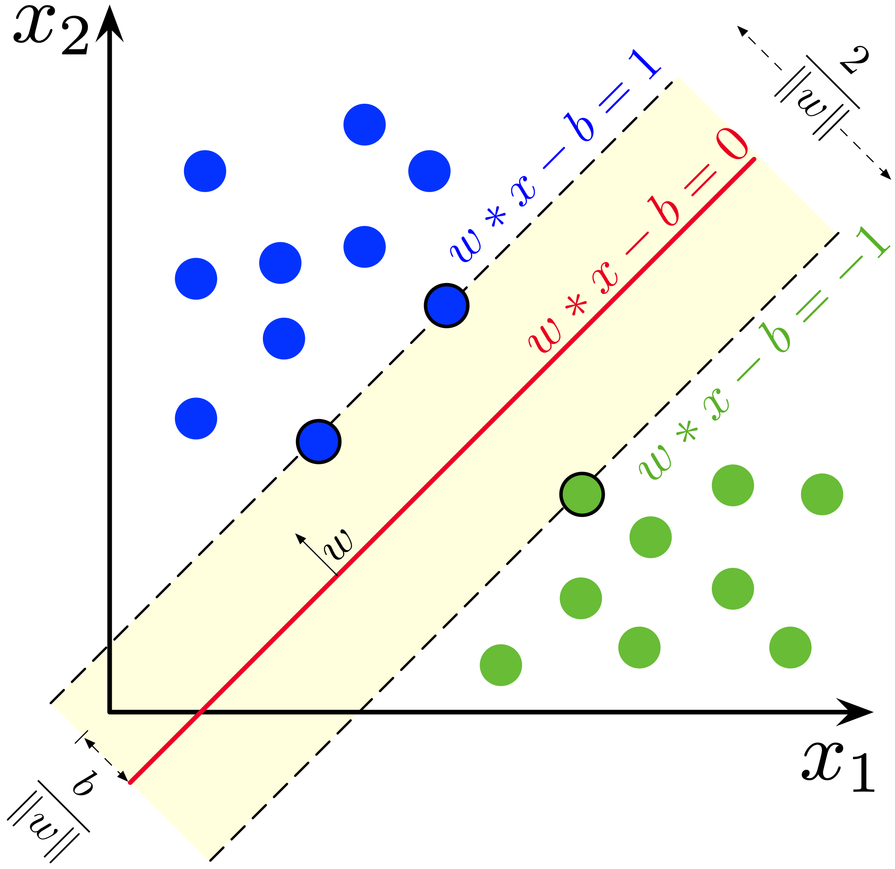
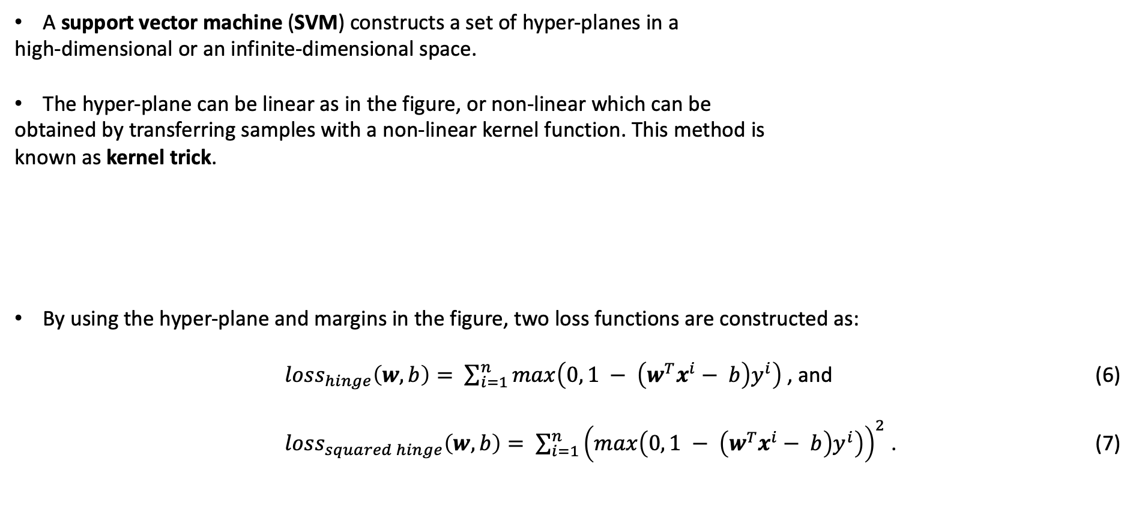
Support Vector Machines
A support vector machine (SVM) constructs a set of hyper-planes in a
high-dimensional or an infinite-dimensional space.
The hyper-plane can be linear as in the figure, or non-linear which can be
obtained by transferring samples with a non-linear kernel function. This method is
known as kernel trick.
By using the hyper-plane and margins in the figure, two loss functions are constructed as:
$loss_{hinge}\left(w, b\right)= \sum_{i=1}^{n}{max\left(0, 1 − \left(w^{T}x^{i}− b\right)y^{i}\right)}$ , and (6)
$loss_{squared hinge}\left(w, b\right)= \sum_{i=1}^{n}{{\left(max\left(0, 1 − \left(w^{T}x^{i}− b\right)y^{i}\right)\right)}^{2}}$ . (7)
Notes:
A support vector machine (SVM) constructs a set of hyper-planes in a high-dimensional or an infinite-dimensional space.
Since we have a binary classification problem, we have a two-dimensional space and one hyper-plane like the red one in the figure with two margins like striped blue and green ones in the figure.
The hyper-plane can be linear as in the figure, or non-linear which can be obtained by transferring samples with a non-linear kernel function. This method is known as kernel trick.
By using the hyper-plane and margins in the figure, two loss functions are constructed as in the equations six and seven.

Slide 27
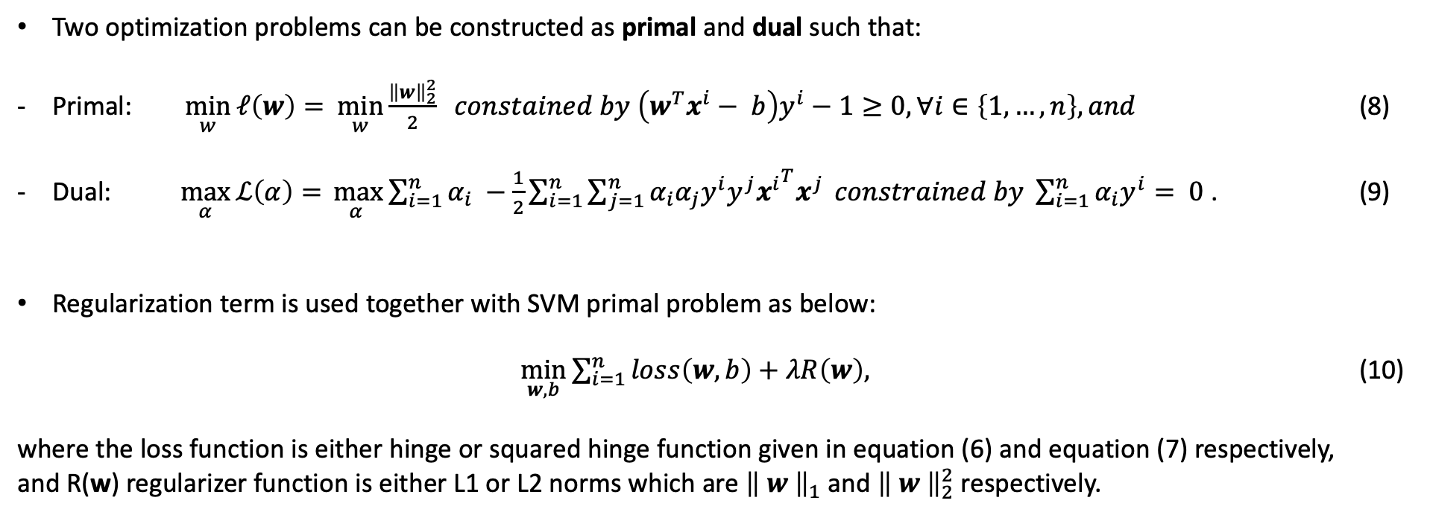
Support Vector Machines
Two optimization problems can be constructed as primal and dual such that:
Primal: $\min_{w}{ℓ\left(w\right)= }$ $\min_{w}{\frac{{\left\|w\right\|}_{2}^{2}}{2} } constained by \left(w^{T}x^{i}− b\right)y^{i}−1≥0, ∀i∈\left\{1, …, n\right\}, and$ (8)
Dual: $\max_{α}{ℒ\left(α\right)= }\max_{α }{\sum_{i=1}^{n}{α_{i} −\frac{1}{2}\sum_{i=1}^{n}{\sum_{j=1}^{n}{α_{i}α_{j}y^{i}y^{j}{x^{i}}^{T}x^{j}}}} constrained by \sum_{i=1}^{n}{α_{i}y^{i}}= 0}$ . (9)
Regularization term is used together with SVM primal problem as below:
$\min_{w, b}{\sum_{i=1}^{n}{loss\left(w, b\right)+λR\left(w\right),}}$ (10)
where the loss function is either hinge or squared hinge function given in equation (6) and equation (7) respectively,
and R(w) regularizer function is either L1 or L2 norms which are ${\left\| w \right\|}_{1}$ and ${\left\| w \right\|}_{2}^{2}$ respectively.
Notes:
Two optimization problems can be constructed as primal and dual.
Regularization term is used together with SVM primal problem as in equation ten.

Slide 28
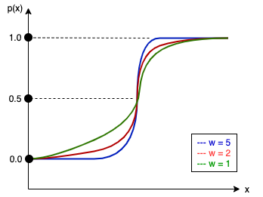
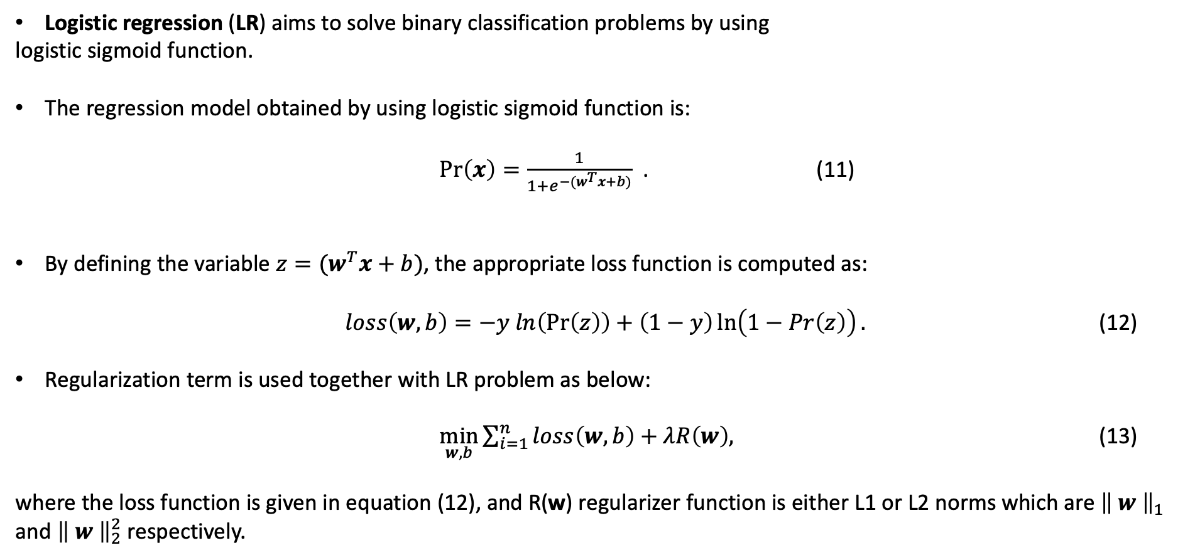
Logistic Regression
Logistic regression (LR) aims to solve binary classification problems by using
logistic sigmoid function.
The regression model obtained by using logistic sigmoid function is:
$\operatorname{Pr}\left(x\right)=\frac{1}{1+e^{−(w^{T}x+b)}}$ . (11)
By defining the variable $z=(w^{T}x+b)$, the appropriate loss function is computed as:
$loss\left(w, b\right)=−y ln\left(\operatorname{Pr}\left(z\right)\right)+\left(1−y\right)\ln\left(1−Pr\left(z\right)\right).$ (12)
Regularization term is used together with LR problem as below:
$\min_{w, b}{\sum_{i=1}^{n}{loss\left(w, b\right)+λR\left(w\right),}}$ (13)
where the loss function is given in equation (12), and R(w) regularizer function is either L1 or L2 norms which are ${\left\| w \right\|}_{1}$ and ${\left\| w \right\|}_{2}^{2}$ respectively.
Notes:
Logistic regression (LR) aims to solve binary classification problems by using logistic sigmoid function.
In the figure, sigmoid function examples for an one-dimensional sample together with different weight values are given.
The regression model can be seen in equation eleven.
By defining the variable z as given, the appropriate loss function is computed as in equation twelve.
Regularization term is used together with LR problem as in equation thirteen.

Slide 29
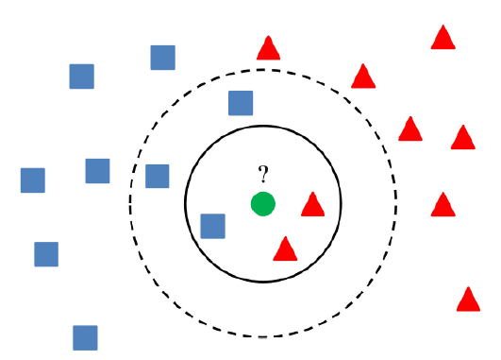
K-Nearest Neighbor
K-Nearest Neighbor (KNN) algorithm aims to label the target sample by placing it into the model hyper-plane and
then using the labels of its neighbors in this hyper-plane.
The neighbors are found by comparing the distances of other samples to the target sample. Euclidean, Manhattan and
Chebyshev metric functions are most commons to compute distances.
After finding the neighbors, the label of the target sample is decided by either majority voting or weighted majority
voting. The difference between two is that, the contributions of all neighbors are equal on majority voting, while the closest neighbor has higher contribution on weighted majority voting.
Notes:
K-Nearest Neighbor (KNN) algorithm aims to label the target sample by placing it into the model hyper-plane and then using the labels of its neighbors in this hyper-plane.
Here, there are two major challenges such that finding the neighbors of target sample over all data and deciding the label of it.
The neighbors are found by comparing the distances of other samples to the target sample.
Euclidean, Manhattan and Chebyshev metric functions are most commons to compute distances.
The number of neighbors that will be used is chosen by the researcher.
After finding the neighbors, the label of the target sample is decided by either majority voting or weighted majority voting.
In the figure, when KNN algorithm with K equals three is used, the green sample is labeled as red both by majority voting and weighted majority voting.
However, when K equals five, the green sample is labeled as blue by majority voting, while it is labeled as red by weighted majority voting.

Slide 30
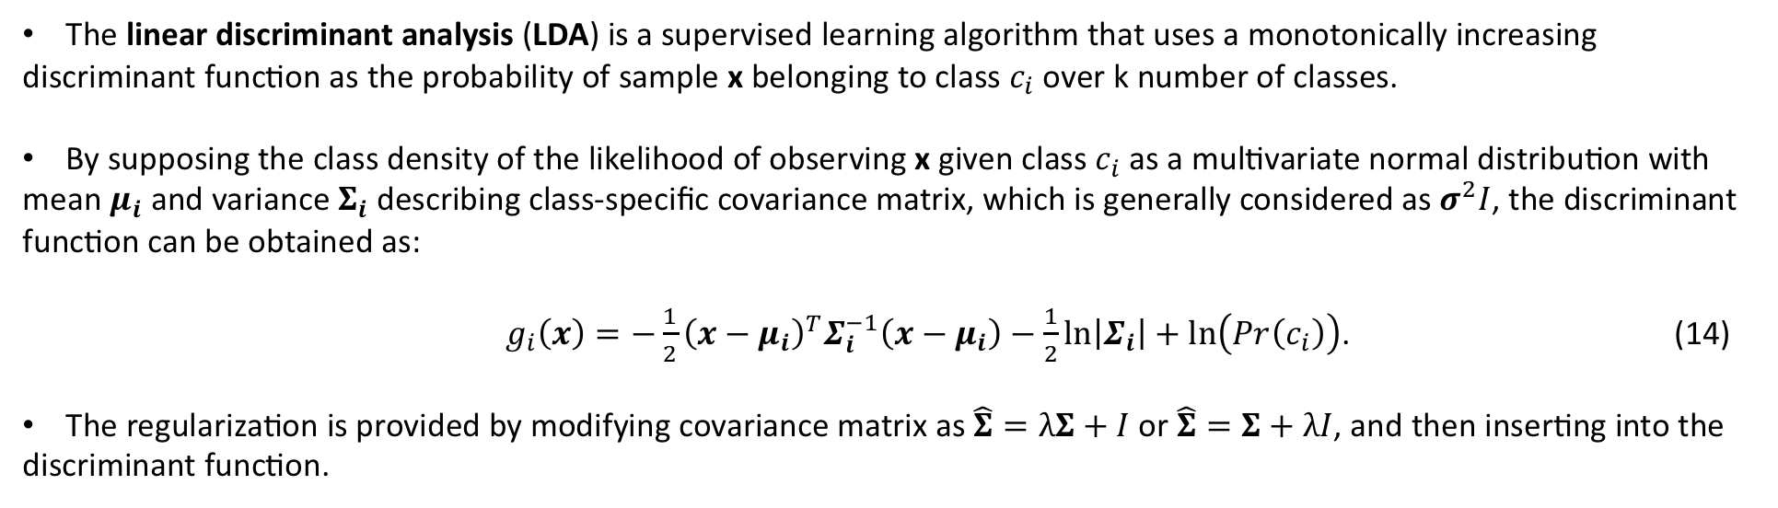
Linear Discriminant Analysis
The linear discriminant analysis (LDA) is a supervised learning algorithm that uses a monotonically increasing
discriminant function as the probability of sample x belonging to class $c_{i}$ over k number of classes.
By supposing the class density of the likelihood of observing x given class $c_{i}$ as a multivariate normal distribution with
mean $μ_{i}$ and variance $Σ_{i}$ describing class-specific covariance matrix, which is generally considered as $σ^{2}I$, the discriminant
function can be obtained as:
$g_{i}\left(x\right)=−\frac{1}{2}{\left(x−μ_{i}\right)}^{T}Σ_{i}^{−1}\left(x−μ_{i}\right)−\frac{1}{2}\ln\left|Σ_{i}\right|+\ln\left(Pr\left(c_{i}\right)\right)$. (14)
The regularization is provided by modifying covariance matrix as $\hat{Σ}=λΣ+I$ or $\hat{Σ}=Σ+λI$, and then inserting into the
discriminant function.
Notes:
The linear discriminant analysis (LDA) is a supervised learning algorithm that uses a monotonically increasing discriminant function as the probability of sample x belonging to class $c_{i}$ over k number of classes.
By supposing the class density of the likelihood of observing x given class $c_{i}$ as a multivariate normal distribution, the discriminant function can be obtained as in equation fourteen.
The regularization is provided by modifying covariance matrix as $lambda times sigma plus identity matrix$or sigma plus lambda times identity matrix, and then inserting it into the discriminant function.

Slide 31
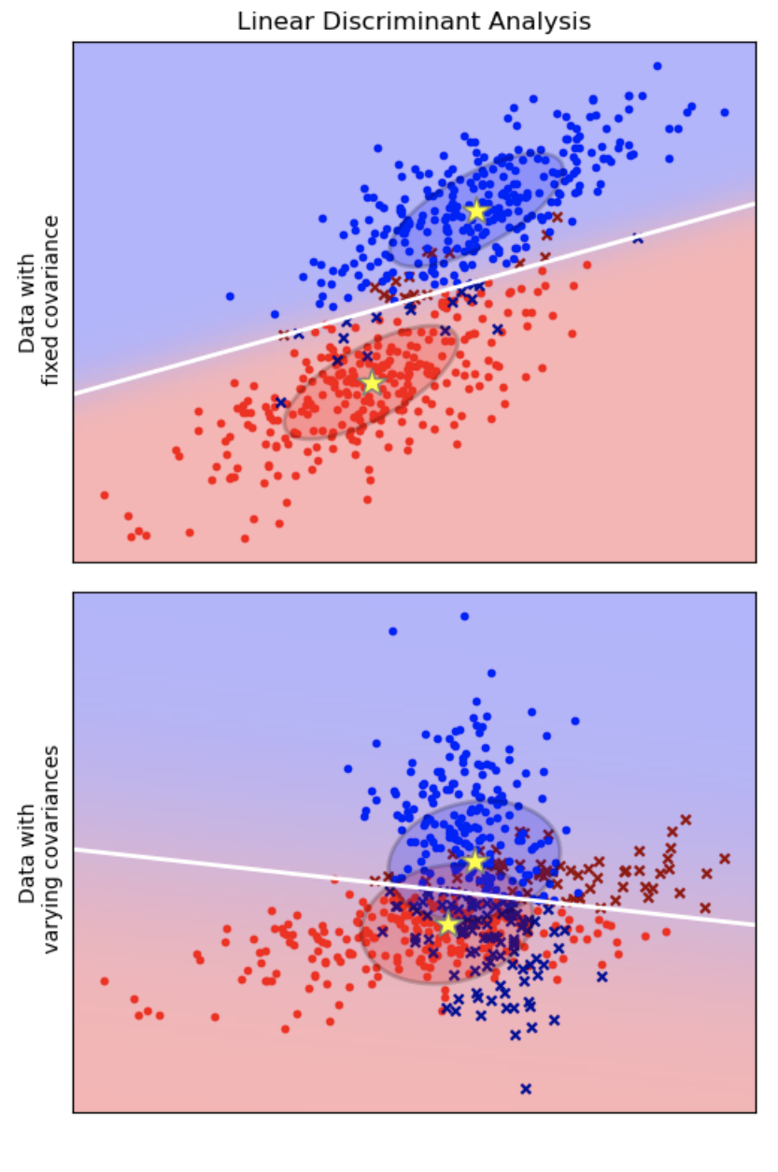
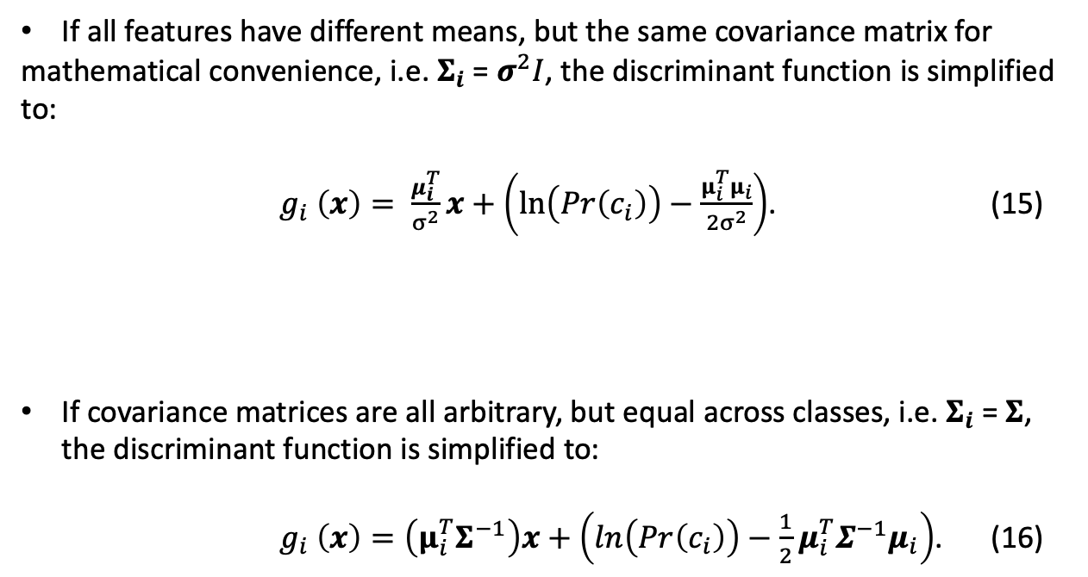
Linear Discriminant Analysis
If all features have different means, but the same covariance matrix for
mathematical convenience, i.e. $Σ_{i}$ = $σ^{2}I$, the discriminant function is simplified to:
$g_{i} \left(x\right)= \frac{μ_{i}^{T}}{σ^{2}}x+\left(\ln\left(Pr\left(c_{i}\right)\right)−\frac{μ_{i}^{T}μ_{i}}{2σ^{2}}\right)$. (15)
If covariance matrices are all arbitrary, but equal across classes, i.e. $Σ_{i}$ = $Σ$, the discriminant function is simplified to:
$g_{i} \left(x\right)=\left(μ_{i}^{T}Σ^{−1}\right)x+\left(\ln\left(Pr\left(c_{i}\right)\right)−\frac{1}{2}μ_{i}^{T}Σ^{−1}μ_{i}\right)$. (16)
Notes:
If all features have different means, but the same covariance matrix for mathematical convenience, the discriminant function is simplified to equation fifteen.
If covariance matrices are all arbitrary, but equal across classes, the discriminant function is simplified to equation sixteen.

Slide 32
Experiments
Dataset and Data Augmentation
Training and Testing on CNN Models
Deep Feature Extraction and Forming the Feature Matrices
Data Pre-Processing
Hyper-Parameter Tuning
Training and Testing on ML Models
Source Code
Notes:
Experiments includes dataset and data augmentation, training and testing on cnn models, deep feature extraction and forming the feature matrices, data pre-processing, hyper-parameter tuning, training and testing on ml models, and technical information about our source code.

Slide 33
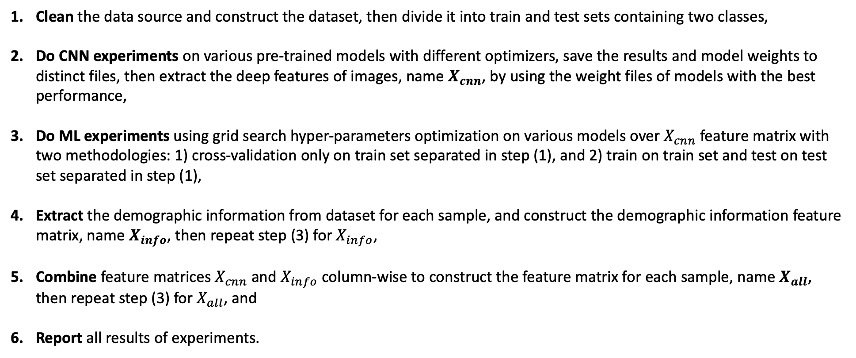
Experiments
Clean the data source and construct the dataset, then divide it into train and test sets containing two classes,
Do CNN experiments on various pre-trained models with different optimizers, save the results and model weights to distinct files, then extract the deep features of images, name $X_{cnn}$, by using the weight files of models with the best performance,
Do ML experiments using grid search hyper-parameters optimization on various models over $X_{cnn}$ feature matrix with two methodologies: 1) cross-validation only on train set separated in step (1), and 2) train on train set and test on test set separated in step (1),
Extract the demographic information from dataset for each sample, and construct the demographic information feature matrix, name $X_{info}$, then repeat step (3) for $X_{info}$,
Combine feature matrices $X_{cnn}$ and $X_{info}$ column-wise to construct the feature matrix for each sample, name $X_{all}$, then repeat step (3) for $X_{all}$, and
Report all results of experiments.
Notes:
The construction stages of the experiments we aim to carry out in the thesis can be listed as:
First, clean the data source and construct the dataset. Then divide it into train and test sets containing two classes.
Second, perform CNN experiments on various pre-trained models with different optimizers, and save the results and weights to distinct files. Then extract the deep features of images by using the weight files of models with the best performance, and declare them as X sub cnn.
Third, perform ML experiments using grid search on various models over X sub cnn with two methodologies: one, cross validation only on train set and test the determined parameters on test set, two train on train set and test on test set.
Forth, extract the demographic information from dataset for each sample, and construct the demographic information feature matrix. Name it as X sub info and perform the ML experiments on it.
Fifth, combine the X sub cnn and X sub info column-wise to construct X sub all, and then perform the ML experiments on it.
Finally, report all results of all experiments.

Slide 34
Dataset and Data Augmentation
Data used in our work was obtained from public GitHub repository https://github.com/ieee8023/covid-chestxray-
dataset. Then it was cleaned by choosing samples including PA view chest X-ray, and gender and age information. Afterwards, data was divided into two groups, COVID-19 and non-COVID-19, by checking whether the diagnosis includes COVID-19 or not.
Then the dataset was split into train and test sets with to ratio of 4 to 1. That is, while the train set includes 105 COVID-
19 and 98 non-COVID-19 labeled data, the test set includes 26 COVID-19 and 25 non-COVID-19.
Afterwards, each datum was resized to 224×224, center cropped, gray scaled, and normalized.
Data augmentation, horizontal flip, vertical flip, 90 degrees of rotation, 180 degrees of rotation, and 270 degrees of
rotation, was used only on train data before CNN experiments.
Table 1: Data distribution.
Class | Original Set | Train Set |  | Test Set
 |  | Chosen | Augmented
COVID-19 | 131 | 105 | 630 | 25
Non-COVID-19 | 123 | 98 | 588 | 26
TOTAL | 254 | 203 | 1218 | 51
Notes:
Data used in our work was obtained from the given public GitHub repository.
Data clean was performed by choosing samples including PA view chest X-ray, and gender and age information. Then data were divided into two groups, COVID-19 and non-COVID-19, by checking whether the diagnosis includes COVID-19 or not.
Then the dataset was split into train and test sets with to ratio of 4 to 1. That is, while the train set includes hundred and five COVID-19 and ninety eight non-COVID-19 labeled data, the test set includes twenty six COVID-19 and twenty five non-COVID-19.
Afterwards, each datum was resized to two hundred twenty four times two hundred twenty four, center cropped, gray scaled, and normalized.
Horizontal flip, vertical flip, ninety degrees of rotation, hundred eighty degrees of rotation, and two hundred seventy degrees of rotation was used as data augmented only on train data before CNN experiments.
Final data sizes can be seen in Table 1.

Slide 35
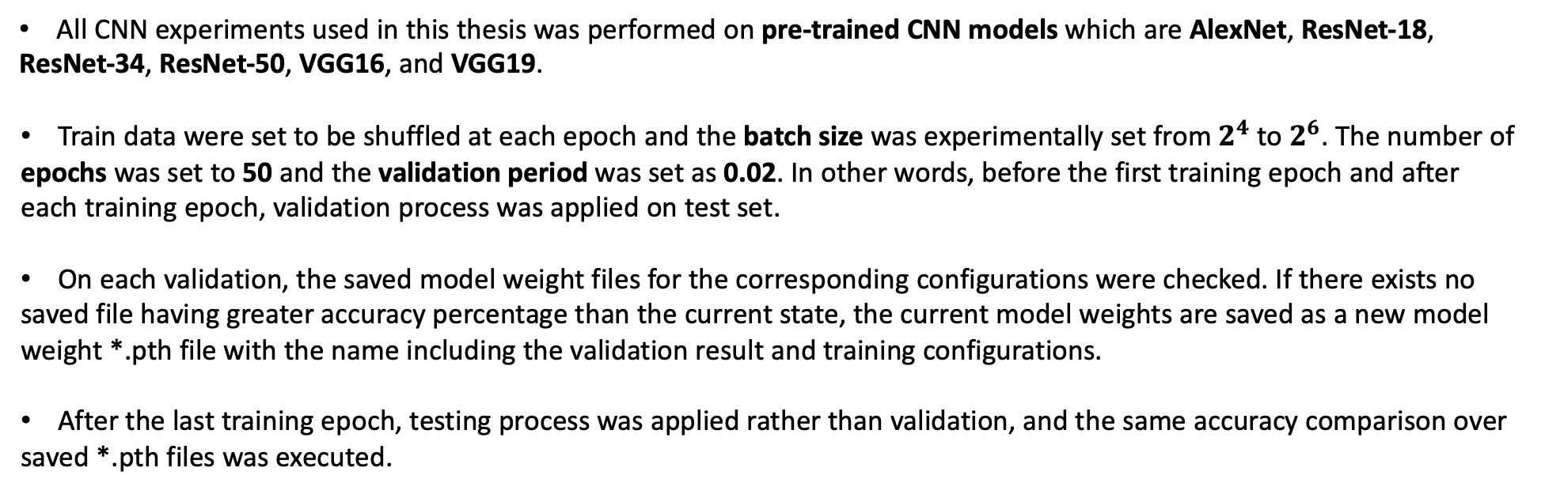
Training and Testing on CNN Models
All CNN experiments used in this thesis was performed on pre-trained CNN models which are AlexNet, ResNet-18,
ResNet-34, ResNet-50, VGG16, and VGG19.
Train data were set to be shuffled at each epoch and the batch size was experimentally set from $2^{4}$ to $2^{6}$. The number of
epochs was set to 50 and the validation period was set as 0.02. In other words, before the first training epoch and after each training epoch, validation process was applied on test set.
On each validation, the saved model weight files for the corresponding configurations were checked. If there exists no
saved file having greater accuracy percentage than the current state, the current model weights are saved as a new model weight *.pth file with the name including the validation result and training configurations.
After the last training epoch, testing process was applied rather than validation, and the same accuracy comparison over
saved *.pth files was executed.
Notes:
All CNN experiments used in this thesis was performed on pre-trained CNN models which are AlexNet, ResNet-18, ResNet-34, ResNet-50, VGG16, and VGG19.
Batch size was experimentally set from two to four to two to six, and train data were shuffled at each epoch. We set the number of epochs to 50 and after each epoch we validated our model.
On each validation, the saved model weight files for the corresponding configurations were checked. If there exists no saved file having greater accuracy percentage than the current state, the current model weights are saved as a new model weight *.pth file with the name including the validation result and training configurations.
After the last training epoch, testing process was applied rather than validation, and the same accuracy comparison over saved *.pth files was executed.
---
We experimented two different transfer learning strategies such that the first is to train the entire model, and the second
is to freeze the first few layers and train others.
Our experiments, which are not reported in this thesis, have shown that training the entire model gives more
minimal losses and more accurate classification results.

Slide 36
Training and Testing on CNN Models
The cross-entropy loss function was used for all CNN models.
To optimize it, SGD momentum, Adam, and AdamW optimizers were experimented with various learning rates,
momentum values, and weight decay parameter values.
The learning rate was experimentally scheduled by the reducing rate as 0.1 for each quarter of total epoch
size.
All pre-trained CNN models were experimented by setting the final layer output as the class size, i.e. 2. Furthermore,
for all architectures experienced in this thesis, a modification was applied onto the classification section by adding a block of ReLU, drop-out, and fully-connected layers right after the last fully-connected layer to adapt the models for our work.
Table 2: Final hyper-parameters for ResNet-50 model.
Optimizer | Learning Rate | Momentum | Weight Decay
SGD Momentum | 1e-4 | 0.9 | -
Adam | 1e-5 | - | 1e-3
AdamW | 1e-5 | - | 1e-4
Notes:
Cross entropy loss function was used for all experiments, and sgd momentum, adam and adam with decoupled weight decay optimizers were experimented with various learning rates, momentum values, and weight decay parameter values to optimize the loss function.
Moreover, learning rate was experimentally scheduled by the reducing rate as 0.1 for each quarter of total epoch size.
All cnn architectures were modified by adding a block of relu, drop-out and fully connected layers right after the last fully connected layer and the final layer outputs were set to the class size, that is two.
For resnet50 model which gave the best results over experiments, the final hyper-parameters used in experiments to yield the best results can be seen in Table 2.

Slide 37
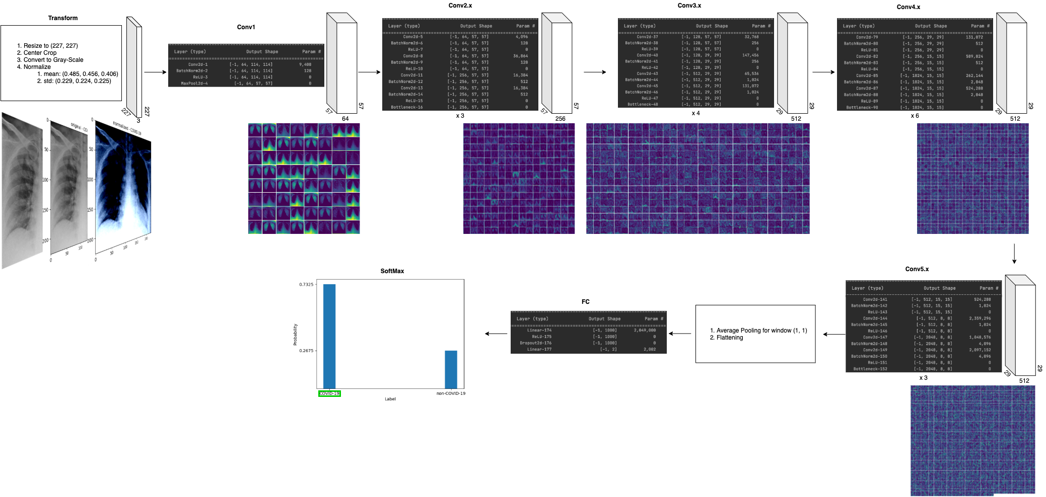
Training and Testing on CNN Models
The sample visualization representing one iteration on ResNet-50 architecture:
Notes:
Here we see the sample visualization representing one iteration on Resnet-50 model. All visualizations were constructed in our source code.

Slide 38
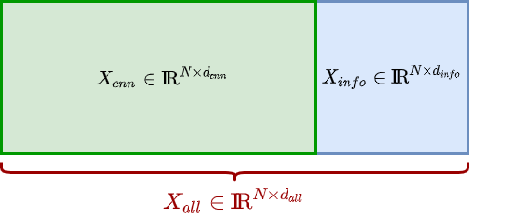
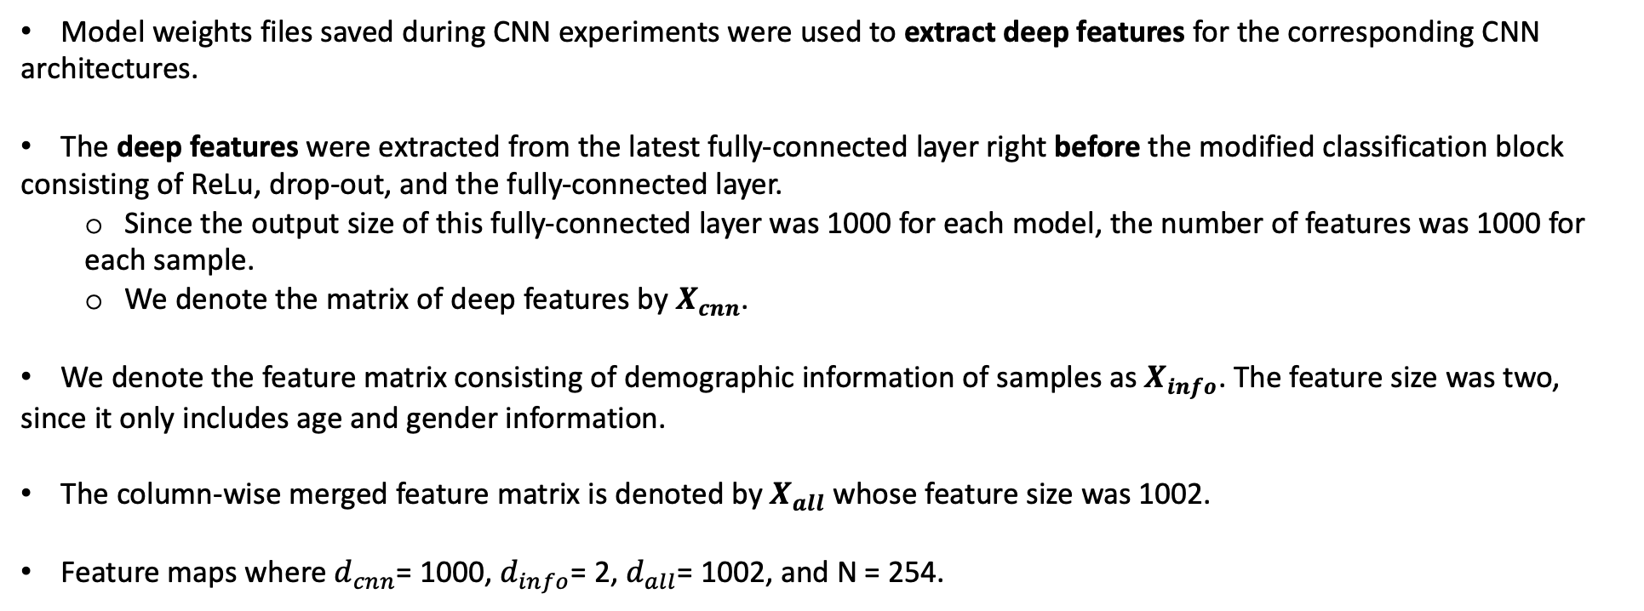
Deep Feature Extraction and Forming the Feature Matrices
Model weights files saved during CNN experiments were used to extract deep features for the corresponding CNN
architectures.
The deep features were extracted from the latest fully-connected layer right before the modified classification block
consisting of ReLu, drop-out, and the fully-connected layer.
Since the output size of this fully-connected layer was 1000 for each model, the number of features was 1000 for
each sample.
We denote the matrix of deep features by $X_{cnn}$.
We denote the feature matrix consisting of demographic information of samples as $X_{info}$. The feature size was two,
since it only includes age and gender information.
The column-wise merged feature matrix is denoted by $X_{all}$ whose feature size was 1002.
Feature maps where $d_{cnn}$= 1000, $d_{info}$= 2, $d_{all}$= 1002, and N = 254.
Notes:
Model weights files saved during CNN experiments were used to extract deep features for the corresponding CNN architectures.
The deep features were extracted from the latest fully connected layer right before the modified classification block.
Since the output of this layer was thousand, the number of features was thousand for each sample.
We denote this feature matrix by X sub cnn.
We denote the feature matrix of demographic information as X sub info, and it has two columns which are the information of age and gender.
The column-wise merged feature matrix is denoted by X sub all and clearly It has thousand and two columns.

Slide 39
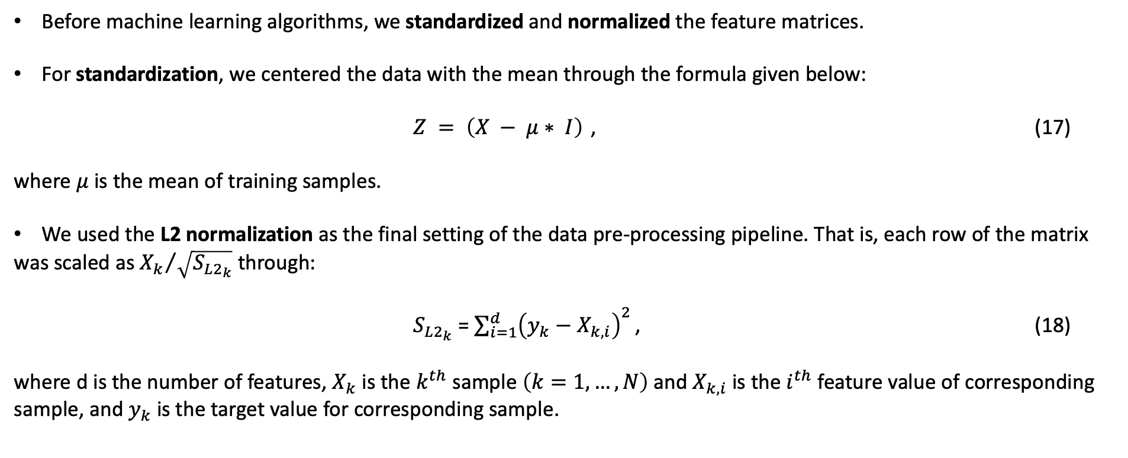
Data Pre-Processing
Before machine learning algorithms, we standardized and normalized the feature matrices.
For standardization, we centered the data with the mean through the formula given below:
$Z = \left(X − μ∗ I\right)$ , (17)
where $μ$ is the mean of training samples.
We used the L2 normalization as the final setting of the data pre-processing pipeline. That is, each row of the matrix
was scaled as ${X_{k}}/{\sqrt{S_{L2_{k}}}}$ through:
$S_{L2_{k}}$ = $\sum_{i=1}^{d}{{\left(y_{k}−X_{k,i}\right)}^{2}}$ , (18)
where d is the number of features, $X_{k}$ is the $k^{th}$ sample $\left(k=1,…,N\right)$ and $X_{k,i}$ is the $i^{th}$ feature value of corresponding sample, and $y_{k}$ is the target value for corresponding sample.
Notes:
Before machine learning algorithms, we standardized and normalized the feature matrices.
For standardization, we centered the data with the mean through the equation in seventeen.
We used L two normalization as the final setting of the data pre-processing pipeline.

Slide 40
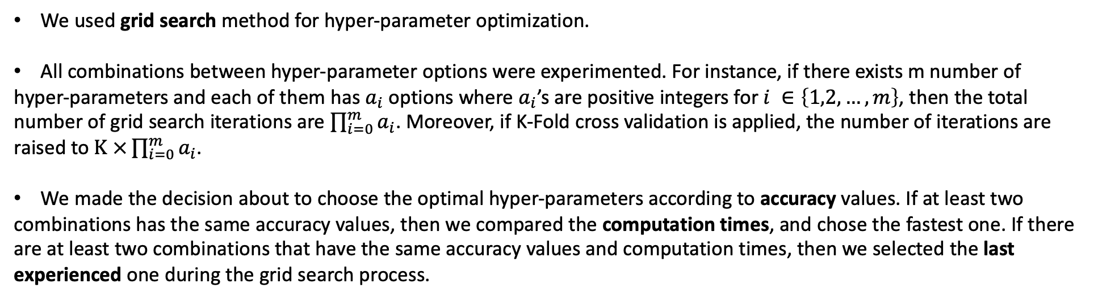
Hyper-Parameter Tuning
We used grid search method for hyper-parameter optimization.
All combinations between hyper-parameter options were experimented. For instance, if there exists m number of
hyper-parameters and each of them has $a_{i}$ options where $a_{i}$’s are positive integers for $i ∈\left\{1,2,…,m\right\}$, then the total number of grid search iterations are $\prod_{i=0}^{m}{a_{i}}$. Moreover, if K-Fold cross validation is applied, the number of iterations are raised to $K ×\prod_{i=0}^{m}{a_{i}}$.
We made the decision about to choose the optimal hyper-parameters according to accuracy values. If at least two
combinations has the same accuracy values, then we compared the computation times, and chose the fastest one. If there are at least two combinations that have the same accuracy values and computation times, then we selected the last experienced one during the grid search process.
Notes:
Grid search method was used for hyper-parameter optimization.
In grid search, all combinations between hyper-parameter options were experimented.
For instance if there exists m number of hyper-parameters and each of them has a sub i options where a sub i’s are positive integers for i from one to m. Then the total number of iterations are the product of a sub i’s for i from one to m.
Moreover, if K-fold cv is applied, the number of iterations are raised K-fold.
We made the decision about to choose the optimal hyper-parameters according to accuracy values. If at least two combinations has the same accuracy values, then we compared the computation times, and chose the fastest one. If there are at least two combinations that have the same accuracy values and computation times, then we selected the last experienced one during the grid search process.

Slide 41
Training and Testing on ML Models
SVM, LR, KNN and LDA algorithms were experienced as ML algorithms by preserving the train and test set partitioning
performed at the beginning.
Penalty options, which are no penalty, lasso penalty and ridge penalty, was experimented separately for feasible ML
algorithms.
Table 4: Algorithms with feasible penalty options.
Algorithm | No Penalty | Lasso Penalty | Ridge Penalty
SVM |  | ✓ | ✓
LR | ✓ | ✓ | ✓
KNN | ✓
LDA | ✓ | ✓
Notes:
SVM, LR, KNN and LDA algorithms were experienced as ML algorithms by preserving the train and test set splitting at the beginning.
Penalty options, which are no penalty, lasso penalty and ridge penalty, was experimented separately for feasible ML algorithms.
As you can see in Table four, SVM was experienced with lasso and ridge penalty, LR with all options, KNN only with no penalty, and LDA with no penalty and lasso penalty.

Slide 42
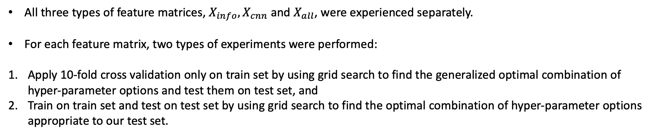
Training and Testing on ML Models
All three types of feature matrices, $X_{info}, X_{cnn}$ and $X_{all}$, were experienced separately.
For each feature matrix, two types of experiments were performed:
Apply 10-fold cross validation only on train set by using grid search to find the generalized optimal combination of hyper-parameter options and test them on test set, and
Train on train set and test on test set by using grid search to find the optimal combination of hyper-parameter options appropriate to our test set.
Notes:
All three types of feature matrices were experienced separately.
For each feature matrix, two types of experiments were performed:
First, apply ten fold cross validation only on train set by using grid search to find the generalized optimal combination of hyper-parameter options and test them on test set, and
Second, train on train set and test on test set by using grid search to find the optimal combination of hyper-parameter options appropriate to our test set.

Slide 43
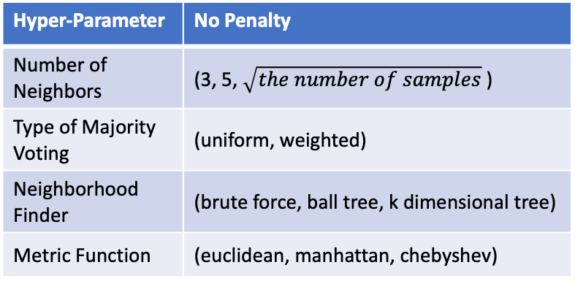
Training and Testing on ML Models
Table 5: SVM hyper-parameter options.
Table 6: LR hyper-parameter options.
Hyper-Parameter | Lasso Penalty | Ridge Penalty
Kernel Function | (linear) | (linear, sigmoid, rbf)
Regularization Parameter | Regularization Parameter List* | Regularization Parameter List*
Hyper-Parameter | No Penalty | Lasso Penalty | Ridge Penalty
Solver Function | (newton-cg, lbfgs, sag, saga) | (liblinear, saga) | (newton-cg, lbfgs, sag, saga, liblinear)
Regularization Parameter | - | Regularization Parameter List* | Regularization Parameter List*
Table 7: KNN hyper-parameter options.
Table 8: LDA hyper-parameter options.
Hyper-Parameter | No Penalty
Number of Neighbors | (3, 5, $\sqrt{the number of samples}$ )
Type of Majority Voting | (uniform, weighted)
Neighborhood Finder | (brute force, ball tree, k dimensional tree)
Metric Function | (euclidean, manhattan, chebyshev)
Hyper-Parameter | No Penalty | Lasso Penalty
Solver Function | (svd, lsqr, eigen) | -
Computing the Weighted Within-Class Covariance (for svd solver) | (Yes, No) | -
Regularization Parameter | - | Regularization Parameter List*
*Regularization Parameter List = (5e-5, 1e-4, 2e-4, 5e-4, 5e-3, 1e-2, 2e-2, 5e-2, 0.1, 0.5, 1.0, 2.0, 5.0, 10.0, 15.0)
Notes:
All experimented hyper-parameter options for ML algorithms can be seen in Tables 5 to 8.

Slide 44
Source Code
Source code of this thesis can be reached on GitHub platform: https://github.com/ozanguldali/modelsWithLASSO.
The GitHub repository includes the dataset, the code for experiments on CNN models and ML algorithms, CNN
model weight files, feature matrices as files, and obtained results as plots and figures.
The project mainly consists of Python programming language.
PyTorch and Scikit-Learn packages were used for CNN and ML experiments respectively.
TULIP package in R programming language was used for the penalized LDA part of ML experiments.
All experiments were performed on Google Colaboratory platform.
Notes:
Source code of this thesis can be reached on GitHub platform as public repository.
This repo includes the dataset, the code for experiments, cnn model weight files, feature matrices as files and reported results.
The project mainly consists of Python programming language.
Pytorch and scikit learn packages were used for cnn and ml experiments respectively. Furthermore, tulip package in R programming language was used for L one penalization of LDA.
All experiments were performed on Google Colab platform.

Slide 45
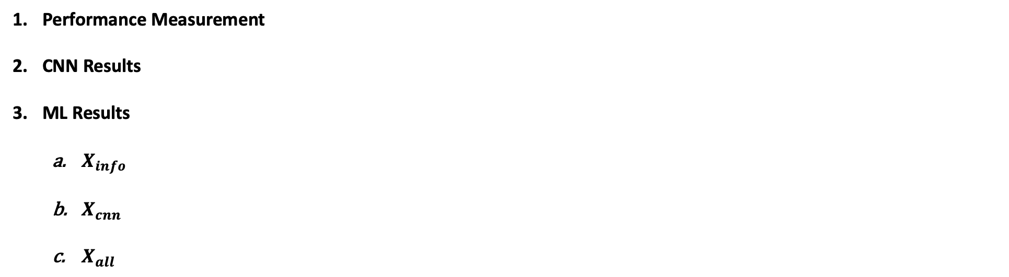
Results
Performance Measurement
CNN Results
ML Results
$X_{info}$
$X_{cnn}$
$X_{all}$
Notes:
Results includes performance measurement, cnn results, and ml results consisting of x sub info, x sub cnn and x sub all results separately.

Slide 46
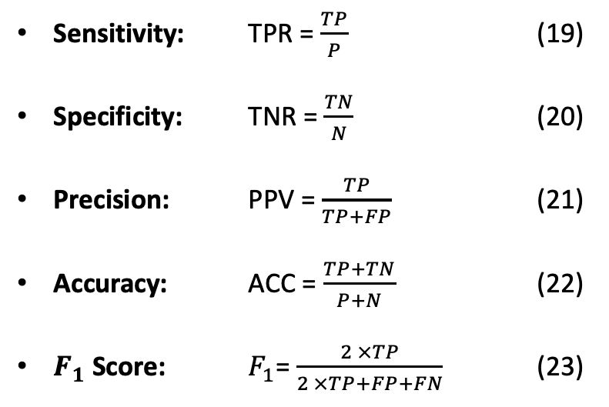
Performance Measurement
Table 9: Confusion Matrix
Positive: P = TP + FN Negative: N = FP + TN |  | Actual
 |  | P | N
Predicted | P | TP | FN
 | N | FP | TN
ROC
Sensitivity: TPR = $\frac{TP}{P}$ (19)
Specificity: TNR = $\frac{TN}{N}$ (20)
Precision: PPV = $\frac{TP}{TP+FP}$ (21)
Accuracy: ACC = $\frac{TP+TN}{P+N}$ (22)
$F_{1}$ Score: $F_{1}$= $\frac{2 ×TP}{2 ×TP+FP+FN}$ (23)
Sensitivity
Random Classifier
Specificity
Notes:
To measure the performance, we mainly used the confusion matrices of experiment results.
Here P and N refers positive and negative values. TP means true positives which are correctly predicted P samples, FP means false positives which are wrongly predicted P samples. TN is correctly predicted negative samples and FN is wrongly predicted negative values.
Sensitivity is computed as TP over P.
Specificity is computed as TN over N.
Precision is computed as TP over TP plus FP.
Accuracy is computed as TP plus TN over all samples and mostly reported in percentage.
F1 Score is computed as two times TP over two times TP plus FP plus FN.
AUC score is the area under ROC curve of results exemplified in the figure.
We computed each sensitivity, specificity, precision, accuracy, and F1-score metric in a weighted way to achieve and report the metrics for the corresponding model, not for each class separately.

Slide 47
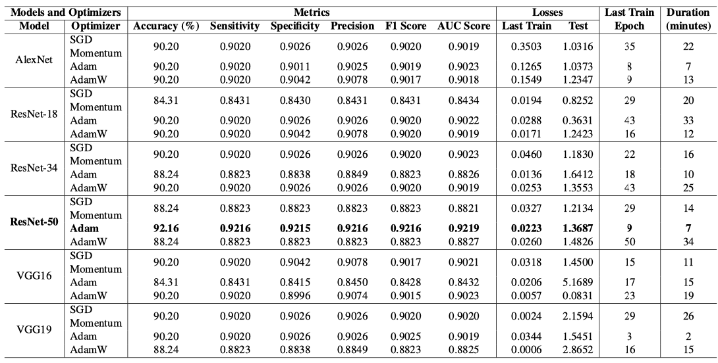
CNN Results
Table 10: Comparison of CNN Experiment Results
Notes:
After all experiments of CNN models and optimizers as I stated previously, the results is in the Table 10.
We obtained the overall best result from ResNet-50 model with Adam optimizer after ninth train epoch in seven minutes with the accuracy, sensitivity, specificity, precision, F1 score and AUC score of ninety two point sixteen percent, zero point ninety two sixteen, zero point ninety two fifteen, zero point ninety two sixteen, zero point ninety two sixteen, and zero point ninety two nineteen respectively, and the loss of ninth train epoch and validation as zero point zero two twenty three and one point thirty six eighty seven.
On the other hand, VGG19 was the model that achieved its best at third epoch with Adam optimizer. Moreover, AlexNet model stand out with its stable metric values, which were always around zero point nine, for all experimented optimizers. In terms of last train loss and test loss, VGG16 with AdamW optimizer had the minimum last train loss as zero point zero zero fifty seven and the minimum test loss as zero point zero eight thirty one.
ResNet-18 and ResNet-34 models achieved metric values around zero point nine; however, they could not reach to ResNet-50 model whose architecture is more deeper than them.
Lastly, it is clear that there can be no generalization about optimizers such that one optimizer is always better than other or vice versa.

Slide 48
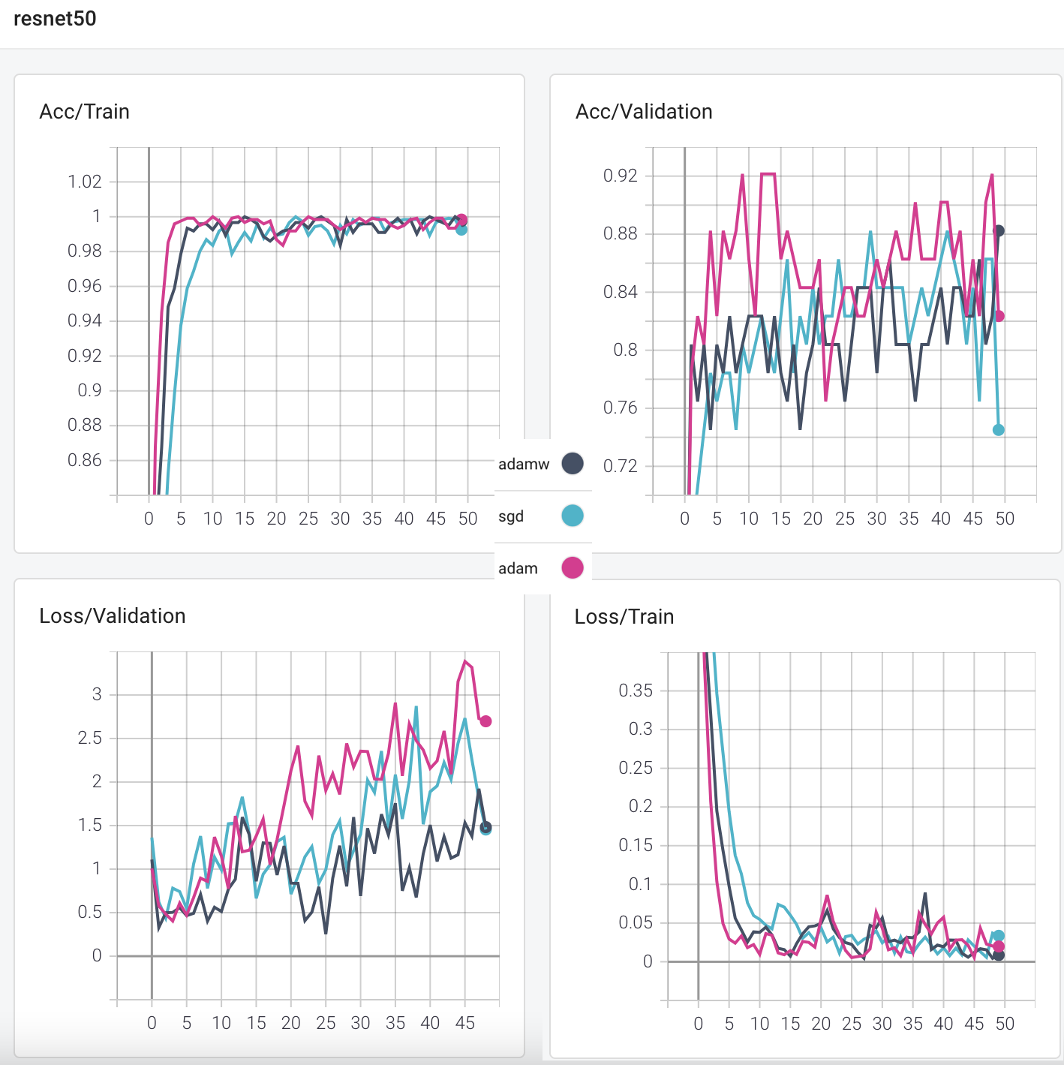
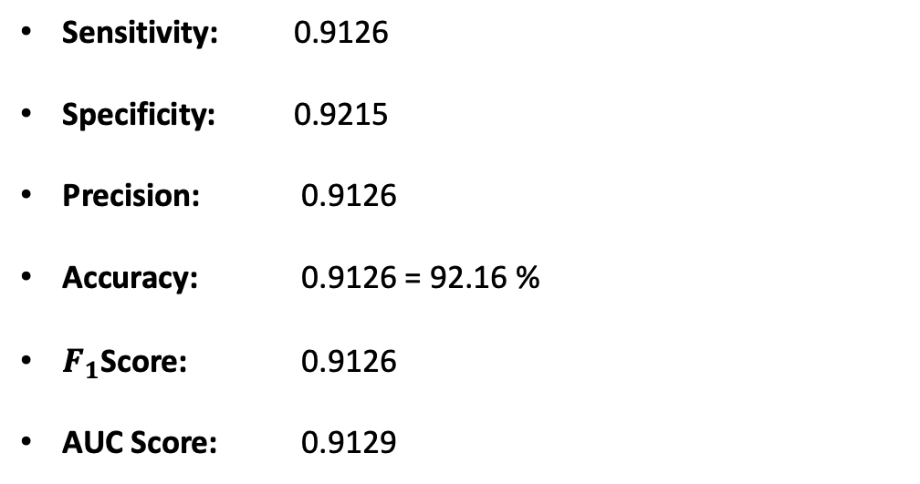
CNN Results
Table 11: Confusion Matrix for ResNet-50 model with Adam optimizer
Positive: P = TP + FN Negative: N = FP + TN |  | Actual
 |  | P | N
Predicted | P | 24 | 2
 | N | 2 | 23
Sensitivity: 0.9126
Specificity: 0.9215
Precision: 0.9126
Accuracy: 0.9126 = 92.16 %
$F_{1}$Score: 0.9126
AUC Score: 0.9129
Notes:
Here, figure shows the accuracy and loss curves for train and validation steps for ResNet-50 model experiments. Black curves represents the Adam-W, blue represents SGD momentum and red represents Adam optimizer.
Moreover, Table eleven shows the confusion matrix for ResNet-50 with Adam optimizer experiment. The metric values can be verified from this confusion matrix.

Slide 49
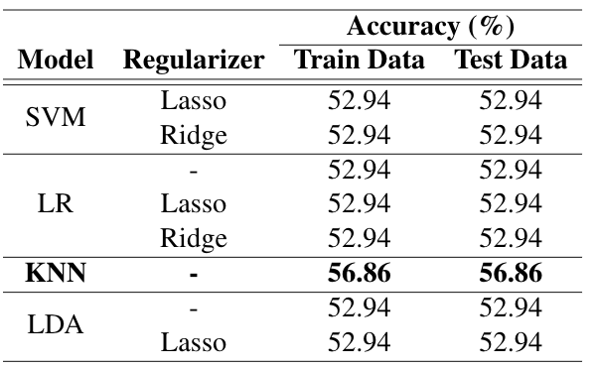
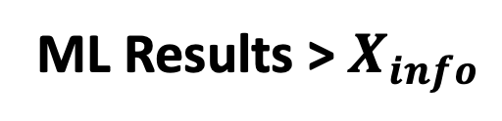
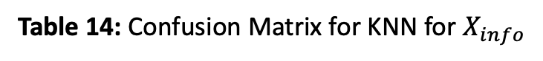
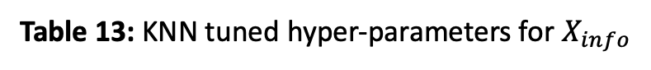
ML Results > $X_{info}$
Table 13: KNN tuned hyper-parameters for $X_{info}$
Table 12: Comparison of ML Experiment Results for $X_{info}$
Hyper-Parameter | Train Data | Test Data
Number of Neighbors | 17 | 17
Type of Majority Voting | uniform | uniform
Neighborhood Finder | brute force | brute force
Metric Function | euclidean | euclidean
Table 14: Confusion Matrix for KNN for $X_{info}$
Positive: P = TP + FN Negative: N = FP + TN |  | Actual |  | Actual
 |  | Train Data |  | Test Data
 |  | P | N | P | N
Predicted | P | 24 | 2 | 24 | 2
 | N | 2 | 23 | 2 | 23
Notes:
Starting from here, “Train data” expression refers the results obtained after getting optimal hyper-parameter by cross-validation on train set, and “Test data” expression refers the results obtained after getting optimal hyper-parameters for test set.
As seen in table twelve, the best result on ML experiments for X sub info was achieved with KNN algorithm. The results of KNN experiments for train data and test data column was the same as the accuracy of fifty six point eighty six percent. Also, the optimal hyper-parameters were the same for this two type of experiments.
Consequently, as expected, the confusion matrices were the same as well.

Slide 50



ML Results > $X_{cnn}$
Table 15: Comparison of ML Experiment Results on Train Data for $X_{cnn}$
Table 16: Comparison of ML Experiment Results on Test Data for $X_{cnn}$
Notes:
Results for all ML algorithms on X sub cnn matrices obtained from the best weight file for each CNN model were reported in tables fifteen and sixteen.
Since we yielded the best CNN result with ResNet-50 model, its X sub cnn matrix also gave the best results on ML experiments.
Here, it can be seen that the accuracies for test data group are always greater than or equal to the accuracies for train data group. This originates from the difference between the tuned optimal hyper-parameters. I will talk about details on coming slides.

Slide 51
ML Results > $X_{cnn}$
Table 17: SVM hyper-parameter options for $X_{cnn_ResNet50}$
Table 18: LR hyper-parameter options for $X_{cnn_ResNet50}$
Hyper-Parameter | Train Data |  | Test Data
Hyper-Parameter | Lasso Penalty | Ridge Penalty | Lasso Penalty | Ridge Penalty
Kernel Function | linear | linear | linear | linear
Regularization Parameter | 5e-3 | 5e-5 | 5e-2 | 5e-5
Hyper-Parameter | Train Data |  |  | Test Data
Hyper-Parameter | No Penalty | Lasso Penalty | Ridge Penalty | No Penalty | Lasso Penalty | Ridge Penalty
Solver Function | newton-cg | liblinear | liblinear | newton-cg | liblinear | linear
Regularization Parameter | - | 2e-2 | 5e-5 | - | 1.0 | 5e-5
Table 19: KNN hyper-parameter options for $X_{cnn_ResNet50}$
Table 20: LDA hyper-parameter options for $X_{cnn_ResNet50}$
Hyper-Parameter | Train Data | Test Data
Hyper-Parameter | No Penalty | No Penalty
Number of Neighbors | 3 | 3
Type of Majority Voting | uniform | uniform
Neighborhood Finder | ball tree | ball tree
Metric Function | euclidean | euclidean
Hyper-Parameter | Train Data |  | Test Data
Hyper-Parameter | No Penalty | Lasso Penalty | No Penalty | Lasso Penalty
Kernel Function | svd | - | svd | -
Computing the Weighted Within-Class Covariance (for svd solver) | Yes | - | Yes | -
Regularization Parameter | - | 5e-5 |  | 5e-3
Notes:
Let handle the x sub cnn matrix for resnet-50 model with adam optimizer and name it as x sub cnn resnet-50.
We have different hyper-parameter choices on SVM with lasso penalty, LR with lasso penalty and LDA with lasso penalty. They are the ones shown the difference between table fifteen and table sixteen.
Here, yellow boxes shows the different hyper-parameter choices.

Slide 52
ML Results > $X_{cnn}$
Table 21: Comparison of metrics on Train and Test for $X_{cnn_ResNet50}$
Model | Regularizer | Train Data |  |  |  |  |  | Test Data
 |  | Accuracy (%) | Sensitivity | Specificity | Precision | F1 Score | AUC Score | Accuracy (%) | Sensitivity | Specificity | Precision | F1 Score | AUC Score
SVM | Lasso | 86.27 | 0.8627 | 0.8665 | 0.8777 | 0.8617 | 0.8646 | 92.16 | 0.9216 | 0.9230 | 0.9243 | 0.9215 | 0.9223
 | Ridge | 92.16 | 0.9216 | 0.9230 | 0.9243 | 0.9215 | 0.9223 | 92.16 | 0.9216 | 0.9230 | 0.9243 | 0.9215 | 0.9223
LR | - | 92.16 | 0.9216 | 0.9230 | 0.9243 | 0.9215 | 0.9223 | 92.16 | 0.9216 | 0.9230 | 0.9243 | 0.9215 | 0.9223
 | Lasso | 86.27 | 0.8662 | 0.8665 | 0.8777 | 0.8617 | 0.8646 | 92.16 | 0.9216 | 0.9230 | 0.9243 | 0.9215 | 0.9223
 | Ridge | 92.16 | 0.9216 | 0.9230 | 0.9243 | 0.9215 | 0.9223 | 92.16 | 0.9216 | 0.9230 | 0.9243 | 0.9215 | 0.9223
KNN | - | 92.16 | 0.9216 | 0.9230 | 0.9243 | 0.9215 | 0.9223 | 92.16 | 0.9216 | 0.9230 | 0.9243 | 0.9215 | 0.9223
LDA | - | 84.31 | 0.8431 | 0.8476 | 0.8648 | 0.8413 | 0.8454 | 84.31 | 0.8431 | 0.8476 | 0.8648 | 0.8413 | 0.8454
 | Lasso | 90.20 | 0.9020 | 0.9042 | 0.9078 | 0.9017 | 0.9045 | 92.16 | 0.9216 | 0.9230 | 0.9243 | 0.9215 | 0.9223
Notes:
Here Table twenty one shows the detailed metric results for x sub cnn resnet50 feature matrix.
We cannot say the best ML algorithm, however we can compare the results.
Results obtained on test data is clearly higher than the results obtained on train data. On the other hand, the worst results were obtained by LDA algorithm for both test and train data performances.

Slide 53



ML Results > $X_{all}$
Table 22: Comparison of ML Experiment Results on Train Data for $X_{all}$
Table 23: Comparison of ML Experiment Results on Test Data for $X_{all}$
Notes:
Results for all ML algorithms on X sub all matrices obtained from the best weight file for each CNN model were reported in tables twenty two and twenty three.
Once again, since we yielded the best CNN result with ResNet-50 model, its X sub all matrix also gave the best results on ML experiments.
Here, accuracies for test data group are always greater than or equal to the accuracies for train data group as well.
Moreover, green boxes shows the accuracies that is greater than the same experiment on x sub cnn.
For example, on deep features extracted from resnet50 model and experiment on LR with lasso penalty, combining x sub info to x sub cnn raises the accuracy value from eighty six point twenty seven percent to eighty eight point twenty four percent.
Note that, the results for x sub all for both train and test data groups are always greater than or equal to the results for x sub cnn.

Slide 54
ML Results > $X_{all}$
Table 24: SVM hyper-parameter options for $X_{all_ResNet50}$
Table 25: LR hyper-parameter options for $X_{all_ResNet50}$
Hyper-Parameter | Train Data |  | Test Data
Hyper-Parameter | Lasso Penalty | Ridge Penalty | Lasso Penalty | Ridge Penalty
Kernel Function | linear | linear | linear | linear
Regularization Parameter | 5e-3 | 5e-5 | 5e-2 | 5e-5
Hyper-Parameter | Train Data |  |  | Test Data
Hyper-Parameter | No Penalty | Lasso Penalty | Ridge Penalty | No Penalty | Lasso Penalty | Ridge Penalty
Solver Function | newton-cg | liblinear | liblinear | newton-cg | liblinear | linear
Regularization Parameter | - | 2e-2 | 5e-5 | - | 2.0 | 5e-5
Table 26: KNN hyper-parameter options for $X_{all_ResNet50}$
Table 27: LDA hyper-parameter options for $X_{all_ResNet50}$
Hyper-Parameter | Train Data | Test Data
Hyper-Parameter | No Penalty | No Penalty
Number of Neighbors | 3 | 3
Type of Majority Voting | uniform | uniform
Neighborhood Finder | ball tree | ball tree
Metric Function | euclidean | euclidean
Hyper-Parameter | Train Data |  | Test Data
Hyper-Parameter | No Penalty | Lasso Penalty | No Penalty | Lasso Penalty
Kernel Function | svd | - | svd | -
Computing the Weighted Within-Class Covariance (for svd solver) | Yes | - | Yes | -
Regularization Parameter | - | 5e-5 |  | 5e-3
Notes:
Let’s again use the similar notation for x sub all resnet-50.
Here, yellow boxes show the different hyper-parameter choices and green one shows the experiment that increased from x sub cnn to x sub all. Also this green box value is change from one point zero to two point zero.
That is, combing x sub info to x sub cnn affects the hyper-parameter choice and some metrics consequently.

Slide 55

ML Results > $X_{all}$
Table 28: Comparison of metrics on Train and Test for $X_{all_ResNet50}$
Model | Regularizer | Train Data |  |  |  |  |  | Test Data
 |  | Accuracy (%) | Sensitivity | Specificity | Precision | F1 Score | AUC Score | Accuracy (%) | Sensitivity | Specificity | Precision | F1 Score | AUC Score
SVM | Lasso | 86.27 | 0.8627 | 0.8665 | 0.8777 | 0.8617 | 0.8646 | 92.16 | 0.9216 | 0.9230 | 0.9243 | 0.9215 | 0.9223
 | Ridge | 92.16 | 0.9216 | 0.9230 | 0.9243 | 0.9215 | 0.9223 | 92.16 | 0.9216 | 0.9230 | 0.9243 | 0.9215 | 0.9223
LR | - | 92.16 | 0.9216 | 0.9230 | 0.9243 | 0.9215 | 0.9223 | 92.16 | 0.9216 | 0.9230 | 0.9243 | 0.9215 | 0.9223
 | Lasso | 88.24 | 0.8824 | 0.8853 | 0.8923 | 0.8818 | 0.8838 | 92.16 | 0.9216 | 0.9230 | 0.9243 | 0.9215 | 0.9223
 | Ridge | 92.16 | 0.9216 | 0.9230 | 0.9243 | 0.9215 | 0.9223 | 92.16 | 0.9216 | 0.9230 | 0.9243 | 0.9215 | 0.9223
KNN | - | 92.16 | 0.9216 | 0.9230 | 0.9243 | 0.9215 | 0.9223 | 92.16 | 0.9216 | 0.9230 | 0.9243 | 0.9215 | 0.9223
LDA | - | 84.31 | 0.8431 | 0.8476 | 0.8648 | 0.8413 | 0.8454 | 84.31 | 0.8431 | 0.8476 | 0.8648 | 0.8413 | 0.8454
 | Lasso | 90.20 | 0.9020 | 0.9042 | 0.9078 | 0.9017 | 0.9045 | 92.16 | 0.9216 | 0.9230 | 0.9243 | 0.9215 | 0.9223
Notes:
Here Table twenty eight shows the detailed metric results for x sub all resnet50 feature matrix.
Once again, we cannot say the best ML algorithm, however the worst results were obtained by LDA algorithm for both test and train data performances as well.
Results obtained on test data is clearly higher than the results obtained on train data. On the other hand, the metrics for LR with lasso penalty is increased compared to X sub cnn.

Slide 56
Conclusion and Recommendations
Future Work
Notes:
Conclusion and recommendations includes future work.

Slide 57
Conclusion and Recommendations
Re-training the deep features obtained from CNN models on ML algorithms provided increases on specificity, precision and AUC score metrics, while there were no increases in accuracy, sensitivity, and F1 score metrics.
The performance of logistic regression algorithm with Lasso penalty was boosted by combining the deep features with
the demographic information. Yet, we did not yield a general improvement when we used this method.
Penalty approach only increased the success of linear discriminant analysis algorithm.
Since we had a small test set, testing on it would not give a sufficiently generalized performance results for our study.
Therefore, our train set was used to obtain the metrics via 10-Fold cross-validation. Moreover, as we expected, generalized results could not reach to the results obtained by testing only on test set.
Notes:
As brief conclusion of our study, I can list four items.
Firstly, re-training the deep features obtained from CNN models on ML algorithms provided increases on specificity, precision and AUC Score metrics, while there were no increases in accuracy, sensitivity, and F1 score metrics.
However, we expect higher increases on metrics by that methodology, if a larger dataset handpicked from a data.
Secondly, The performance of logistic regression algorithm with Lasso penalty was boosted by combining the deep features with the demographic information. Yet, we did not yield a general improvement when we used this method.
However, we expect to have better results on X sub info and have better boosts on X sub all, if more information from patients such as doctors report, tobacco product use, associated genetic diseases, etc. can be reached and used.
As the third, Penalty approach on machine learning experiments only increased the success of linear discriminant analysis algorithm.
Lastly, since we had a small test set, testing on it would not give a sufficiently generalized performance results for our study.
Therefore, our train set was used to obtain the metrics via 10-Fold cross-validation. Moreover, as we expected, generalized results could not reach to the results obtained by testing only on test set.

Slide 58
Future Work
Any image classification problem, either binary or multi-class, can be studied as a future work.
If the study data set consisting of images also includes non-image information, this thesis can be used as a guide
for corresponding classification problem.
More non-image information about samples such as tobacco product use, clinical information, associated genetic
diseases, and respiratory test information would increase the performance of the study.
A bigger dataset constructed by getting advices and supports from expert radiologists and chest disease specialists
would help to reach better results.
This study can be extended by using:
Various deep learning optimizers such as Adagrad and Padam,
Various machine learning regularizers such as elastic net, and
Ensemble learning methodology either for CNN experiments or ML experiments.
Notes:
Finally, I have some suggestion and recommendation about future works.
Any image classification problem, either binary or multi-class, can be studied as a future work of this thesis.
If the study dataset consisting of images also includes non-image information, this thesis can be used as a guide for corresponding classification problem.
More non-image information about samples such as tobacco product use, clinical information, associated genetic diseases, and respiratory test information would increase the performance of the study.
A bigger dataset constructed by getting advices and supports from expert radiologists and chest disease specialists would help to reach better results.
Furthermore, our study can be extended by using:
Various deep learning optimizers such as adagrad and p-adam,
Various machine learning regularizers such as elastic net, and
Ensemble learning methodology either for CNN experiments or ML experiments.

Slide 59
Thank you for listening!
Q&A

